Slide 1
Smallholder Diagnostic Study of Oil Palm Landscape in India across Assam and Andhra Pradesh
Final Research Report
April | 2024

Slide 2
Executive Summary
Oil Palm Landscape in India & Introduction to the Study
Research Methodology
Farmer Profile and Productivity
Institutional Support and Market Linkages
Emerging Archetypes, Key Constraints and Recommendations
Annexure
References
Contents

Slide 3
Executive Summary

Slide 4
Executive Summary I This report provides a baseline report on the profile and characteristics of smallholder oil palm farmers in Andhra Pradesh and Assam, maps their readiness to move towards sustainable practices, and accordingly proposes strategies and interventions
Farmer Constraints and Readiness
Proposed Interventions
All farmers in Andhra Pradesh have land titles, as compared to Assam where significant % lacks titles
While participation of women is slightly higher in Assam as compared to Andhra Pradesh, overall participation is low
Ecosystem Engagement
Improve coordination within the ecosystem actors and promote sustainable oil palm
Land Legality
Women Participation
All farmers in Andhra Pradesh use agricultural land, as compared to Assam where farmers are also using forest and common land
Child labour is not prevalent in either of the states
Nature of
Land
Risk of Child Labour
Smallholder Training
Training farmers on technical and management components related to oil palm cultivation
Majority of the farmers are not associated with any farmer groups in both the states
There is a higher use of fertilizers in Andhra Pradesh as compared to Assam
Organization into Groups
Fertilizers
Certification Process
Ensuring palm oil cultivation is sustainable, responsible and profitable for all the entities involved
Farmers in Assam showed a greater willingness for RSPO certification as compared to Andhra Pradesh
Majority of farmers use rainwater and groundwater in Assam and Andhra Pradesh respectively
Willingness
Irrigation

Slide 5
Oil Palm Landscape in India
and Introduction to the Study

Slide 6
India accounts for 8.4 million metric tons of palm oil consumption per year and in the absence of sufficient domestic production of the crop the country has also become the largest global importer of palm oil
Global Landscape of Palm Oil Production
Palm oil market valued at USD 62.94 billion in 2021, projected to reach USD 99.41 billion by 2030 with a CAGR of 5.21%
Asia-Pacific leads with over 71% of market share in 2021, driven by growing populations and diverse food applications in countries like India and China
The major oil palm producing countries are Indonesia, Malaysia, and Thailand, with India producing nearly no palm oil itself, relying heavily on imports to meet its demand
Global production of oil palm (in metric tons)
Source: statista.com
Palm Oil Production in India
16.89
lakh MT
2.72
lakh MT
 | India is the world's largest palm oil importer and imported 8.4 million metric tonnes (MMT) of palm oil in 2020-21, constituting around 18% of global imports
 | The actual fruiting area for oil palm in India is only 1.87 lakh hectares, but a reassessment committee has assessed a total area of around 28 lakh hectares.
Oil palm FFBs produced in India
Crude Palm Oil produced in India
84% of domestic production is from Andhra Pradesh with 2.5 Lakh MT Crude Palm oil production in 2023-24
To reduce dependence on edible oil imports, India aims to increase production of oil palm to 1.12 million tonnes across 1 million hectares by 2025–26, and to 2.8 million tonnes across 6.6 million hectares by 2030
Source: 1. Aggarwal, M. (2021, August 5). Mongabay-India. 2. India: palm oil consumption 2022 | Statista. (2024, February 12). Statista 3. NMEO-OP Operational Guidelines

Slide 7
To boost domestic production of palm oil, policies and schemes promoting expansion of acreage and yield from oil palm across selected priority states are being implemented at Central and State levels
The National Mission on Edible Oils - Oil Palm (NMEO-OP) has the aim to enhance the edible oilseeds production and oils availability in the country by harnessing Oil Palm area expansion, increasing CPO production and to reduce import burden on edible oils. It is currently being implemented alongside other State level policies across priority 22 states and UTs, with a focus on the North East region and Andaman & Nicobar Islands.
National Level Policy/Scheme
State Level Policies
The National Food Security Mission-Oil Palm (NFSM-OP) and the National Mission on Edible Oils (NMOOP), 2021 are the key national schemes
Andhra Pradesh
Plantations were encouraged through the DBT (Direct Beneficiary Transfers) scheme in 3 districts (East Godavari, West Godavari & Krishna) in 1992 with support from Dept of Horticulture
The Andhra Pradesh Oil Palm (Regulation of Production and Processing) Act, 1993 and concurrently Andhra Pradesh Oil Palm (Regulation of Production and Processing) Rules, 2008 determines the current production and processing regulations-
Regulation of cultivation
Designation of factory zones linked to processing facilities
Processing and marketing
NFSM-Oil Palm
NMEO-OP
Focus: Providing financial assistance for specific activities like planting, irrigation, and fertilization.
Area limit: 15 hectares per beneficiary
Target group: Primarily small and marginal farmers
Focus: Broadly promoting oil palm cultivation through various initiatives like, financial assistance, research, infrastructure development, and market linkages.
Area limit: No specific land holding limit
Target group: All stakeholders involved in the oil palm value chain, including farmers, processors, traders
Assam doesn’t have a state level policy regulating the production of oil palm yet.
The key stakeholders supporting the implementation of these policies along with their roles within the institutional environment has been detailed out here
Source: Primary Interaction with Dept of Horticulture, Govt of AP; Sattva Analysis

Slide 8
NMEO-OP is a Centrally Sponsored Scheme being implemented in 20 states covering 284 districts in India over a period of five years with the aim to enhance the edible oilseeds production and oils availability in the country
The reassessment committee of ICAR- Indian Institute of Oil Palm Research (IIOPR) 2020 has assessed in the year 2020, a total area of around 28 lakh hectares fit for oil palm cultivation in India. Out of the total 27.99 lakh ha potential area, an area of 18.37 lakh is in the general states, and 9.62 lakh in the North-Eastern States.
Key strategies under the NMEO-OP
Key features of NMEO-OP
Increasing production of seedlings by establishment of seed garden nurseries of oil palm to assure domestic availability of seedlings
Improving productivity of FFBs
Increasing drip irrigation coverage under oil palm
Diversification of area from low yielding cereals crops to oil palm
Inter-cropping during gestation period of 4 years, would provide economic return to the farmers when there is no production
In addition to supporting farmers with subsidies and supply of planting material, intercropping during gestation period, drip irrigation etc., the scheme has introduced a Viability Price (VP)* to insulate them from fluctuations in the international price. If the payment to farmers by the industry is below the VP, the Government will provide a Viability Gap Payment (VGP).
Farmers
In order to provide a complete package for oil palm development, new mills will be setup in NE states @ 50% of the cost limited to Rs. 500.00 lakhs for a FFB processing unit of 5 MT/hr for newly planted oil palm area. The land for mills will be provided by the State Govt to the processor on lease / rent / purchase basis.
Processors
*VP of FFB per ton shall be 14.3% of the annual average price of CPO of the last 5 years adjusted with wholesale price index (WPI) of all India.

Slide 9
While there are some inter-state variations, the State Department of Agriculture / Horticulture, Central University, ICAR Institutions, Oil palm processors / Associations, and DD Kisan among others are the key implementing stakeholders of the NMEO-Oil palm
Central Government
Communicate guidelines, subsidies and, targets to be achieved
Company
Nodal agency
(Department of Agriculture or Horticulture)
Company Manager
Area Managers / Supervisors
Field Staff
State Government
Allotment of feasible/ potential mandals i.e. local government area to the companies by the notifications.
Approval of Annual Action Plan for every year by conducting SLSC* meeting
Follow guidelines communicated by commissioner
Motivate farmers and conduct field visits
Distribution of plant material / seedlings to farmers
Commissioner
Preparation and issue of guidelines to the District Horticulture Officers and Companies
Farmers
Additional Director
District Horticulture / Agriculture Officers
Horticulture / Agriculture Officers
Panchayati Level Officers
Timely review of the schemes, monitoring the coordination between the companies and departmental staff
Communicate the guidelines and motivate farmers at a district level
Motivate the farmers by conducting field visits and pursue seedling distribution to farmers
Registration and permits for farmers. Helping the farmers in
Plantations and farmer
applications for subsidies
*State Level Sanctioning Committee

Slide 10
Sustainability of Oil Palm in India | As India tries to gain self sufficiency in oil palm production, it is important to ensure negative environmental and social consequences are mitigated
Countries such as Malaysia and Indonesia have witnessed large scale deforestation, loss of biodiversity and wildlife, and instances of human rights and labour rights violations
Initiatives and stakeholders promoting sustainable palm oil production and conservation of biodiversity, while supporting smallholder farmer livelihoods include:
IDH, the Sustainable Trade Initiative ¹
Running the Sustainable Production of Palm Oil (SPPO) program
Focused on promoting best practices in palm oil cultivation, including sustainable land use, biodiversity conservation, and community engagement
Indian Palm Oil Sustainability Framework (IPOS)²
Developed by Solidaridad in collaboration with the palm oil industry and stakeholders
Aims to promote sustainable palm oil production in India through guidance and support to producers, processors, and traders
Centre for Sustainable Agriculture (CSA)
Works with smallholder farmers to promote sustainable agriculture practices, including palm oil cultivation
Focuses on promoting agroecology, biodiversity conservation, and community empowerment in the palm oil sector
Environmental and social considerations are accounted for while selecting the land for expansion as well as designing / implementing the scheme.
For example, only farmers who have land titles, access to sufficient water, and suitable land are allowed to enroll and grow oil palm.
However in India, the palm oil cultivation and market is highly regulated:
The policy enables direct linkages between the company and the farmer, reducing middlemen within the value chain
Farmers are entitled to a government determined price – the policy protects them from volatility in international prices
Ownership of land and agency remains with the farmer – one company is allocated per region for procurement
Implementation of the policy is unable to address granular and region-specific risks such as biodiversity loss, water shortages, human-wildlife conflicts, impact on local and indigenous communities etc, lack of market linkages etc.
As RSPO aims to expand its footprint in India and promote the production and distribution of certified sustainable oil palm products in India, this study aims to increase understanding of the existing oil palm production systems across India, with the aim to identify opportunities and interventions for promoting sustainable oil palm cultivation.
¹ IDH Palm-market-India, ² IPOS framework by Solidaridad,

Slide 11
Research Methodology

Slide 12
Sattva has used quantitative and qualitative research methods to explore the landscape of smallholder cultivation of oil palm across two states in India- Assam and Andhra Pradesh (AP)
Key Objectives for the survey
Compile a baseline of smallholder data and demographics to understand the landscape of oil palm farmers in Assam and Andhra Pradesh
Identify the potential sustainability (environmental, social, and profitability in the long term) risks of the current cultivation and the proposed expansion
Mapping level of readiness for smallholders to move towards sustainable practices and propose actionable strategies/interventions
Areas of enquiry
Smallholder characteristics mapping
Overview of the landscape
Who are the farmers growing oil palm?
What are the yield and production trends?
What are the key support from and gaps in institutional environment?
What are the social, economic and environmental impacts?
Demographic and socio economic characteristics of farmers
Farm Profile
Landholding pattern and size of holding
Crop mix
Resource Use
Age of plantation and ownership
Intra and inter state differences
Reasons for uptake of oil-palm farming
Key success factors and key challenges
Yield and Productivity
Cost and income
Farm inputs - natural resources and agrochemicals
Technical inputs and machinery use
Farm maintenance
Harvesting and yield
Institutional Environment
Level of organization of farmers and key stakeholders
Private sector and Govt support and schemes
Nature of contracts or customary agreements
Access to market, resources
Social and Environmental Impact
Social impact at household level and community level changes in income, landholding, working conditions
Environmental impact and sustainability practices
Total Nos of Smallholder farmer Surveys: 188
Total Nos of Smallholder farmers covered through FGDs: 43

Slide 13
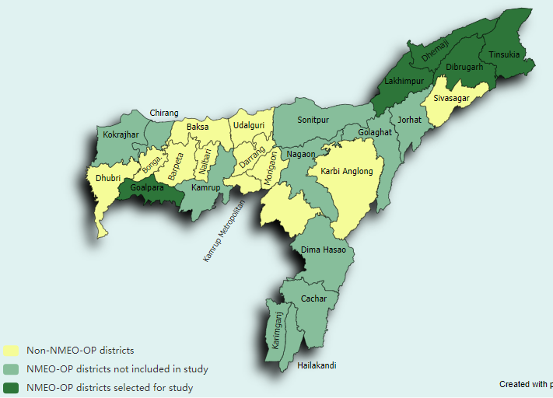
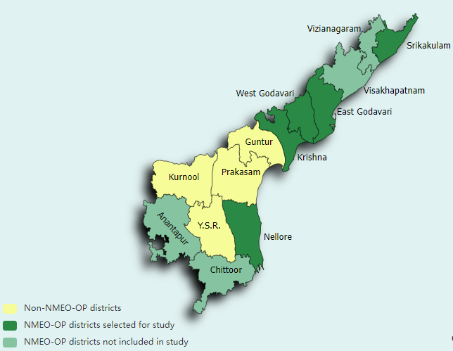
Primary research using mixed methods was conducted across 10 districts of the two states and covered a total of ~230 smallholder farmers, besides other stakeholders
Assam
Andhra Pradesh
Total Number of Farmers Part of the Study | Number of Farmers covered in Surveys | Number of Farmers covered in FGDs
112 | 79 | 33
Total Number of Farmers Part of the Study | Number of Farmers covered in Surveys | Number of Farmers covered in FGDs
125 | 111 | 9

Slide 14
Interviews with other key ecosystem stakeholders allowed for triangulation and optimization of data gathered through the farmer surveys, while providing insights on market linkages, institutional support and challenges for palm plantations
Government
Private Corporations
Research Organizations
Farmer Cooperatives
District Agriculture Officer, Tinsukia
District Agriculture Officer, Lakhimpur
District Agriculture Officer, Goalpara
Oil Palm Growers Coordination Committee, Goalpara
Kunkrajani Oil Palm Group
Mili Juli Women Farmers Group
Assam
Additional Director of Horticulture (Planning, Establishment, RKVY & NMOOP)
Assistant Director of Horticulture, Nellore
Horticulture Assistant, West Godavari
Chinthalapudi Fed Producer Company Ltd.
(not oil palm specific, but farmers in the FPO have some oil palm plantations)
Andhra Pradesh
Policy Implementation of NMEO-OP
Market linkages and incentives to farmers
Sustainability and expansion of oil palm cultivation
Market linkages and role of corporates in NMEO-OP
Initiatives and best practices across the value chain
Challenges and constraints across the value chain
Characteristics of current production areas
Scope for sustainable growth and expansion
Sustainability risks and opportunities
On ground insights and challenges faced by farmers
Market linkages and prevailing prices
Practices followed by farmers and sources for the same
Key Areas of Enquiries

Slide 15
Limitations of the Study I The study had certain limitations and risks associated with primary data collection and interpretation, the Sattva team has highlighted the specific limitations and mitigation strategies followed to counter them
Challenges
Mitigation Measures
Limited Availability of farmers, data collection schedule coinciding with harvest festivals: Due to the pre-decided timelines of the engagement, some data collection schedules coincided with local harvest festivals across AP and Assam, leading to limited availability of farmers for interviews. | Working with local farmer SPoCs to ensure availability and turnaround of farmers Conducting telephone interviews in case all farmers are not available for in-person visits and surveys
Limited Availability of Value Chain stakeholders: The engagement scope demanded interactions with a number of key government, NGO as well as corporate stakeholders across the palm oil value chains, however availability and willingness of all stakeholders to participate was limited. | Utilizing existing RSPO networks to schedule interviews/discussions Utilizing existing Sattva network to target stakeholders Building field level connects with stakeholder organizations through Agri-Horti shows and engagement to increase stakeholder willingness and participation in the study
Limited recall and accuracy of financial and productivity data by farmers: Smallholder farmers do not maintain proper written records of income, sales and harvests which led to recall bias during interviews | Collecting data on multiple variables related to income (e.g. average yield, total yield, sale price, number of harvest etc) to triangulate and validate farmer responses Optimizing data based on benchmarks and inputs from local and topical experts
Subjectivity of responses: Individual perspectives and biases may influence responses to certain questions (e.g. availability of government support) | Such questions were probed further in FGDs to understand the rationale and validated through conversations with other relevant stakeholders

Slide 16
Farmer Profile and Productivity

Slide 17
Farmer Profile: Gender and Category I Assam has greater participation from women as well as scheduled tribes as primary farmers in decision making roles compared to Andhra Pradesh
 | Of the farmers we spoke to 95% were male and 5% were female farmers |  | Farmers spoken to were spread across the social categories (general, OBC, SC, and ST)
Graph with state wise distribution of gender distribution.
Graph with state wise distribution oil palm farmers in various social categories.
40.5%
54%
(n=111)
(n=111)
58%
26%
(n=78)
(n=78)
Assam’s higher representation of women can be linked to the matrilineal system among specific tribes such as Garo and Khasi which allows women to have land rights 5 out of 8 of women who were interviewed as part of the survey in Assam were from the ST category
Among the ST population in Assam the Rabha and Garo tribes in Goalpara and Mising tribe in Dhemaji are some of the notable ones. While lack of ST and SC farmer participation in AP demands further exploration, boosting their participation in oil palm landscape can be a key intervention area for RSPO.
38%
43%
Caste forms an interesting dimension within oil palm farmers in Assam and AP, with most farmers in AP belonging to the General category while in Assam farmers belong to the ST and OBC category largely (81%). RSPO’s interventions in AP can focus on dissemination of technical knowledge and information on govt incentives and subsidies’ to all social groups to promote farmers from socially marginalised backgrounds to take up oil palm
Source: Primary Interviews across AP and Assam, Sattva Analysis
Notes:
Ranges to show overall how much land is being used
District wise = % average and ranges – % of land allocated for oil palm - insights on the farmer priorities and the perceived value of oil palm as a commercial crop

Slide 18
Farmer Profile: Age and Education I Oil Palm cultivation in Assam and Andhra Pradesh reflect an aging group of farmers with a significant number of illiterate farmers in Andhra Pradesh (31%)
 | Oil Palm Farmers ranged from 20-85 years of age and had varied education statuses |  | Of the farmers we spoke to 55% farmers have studied till below 10th standard in Assam and 31% farmers are illiterate in AP.
Graph with state wise distribution of the age range of farmers.
Graph with state wise distribution of the educational qualification of farmers.
(n=111)
(n=111)
(n=78)
(n=78)
Assam has younger farmers (58% between 35-50 yrs) taking up oil palm, however in AP a large section of farmers that are over 50 years of age, indicating an ageing population of farmers associated with the crop
Assam has farmers who have studied below 10th standard (55%) taking up oil palm, however in AP a large section of farmers that are illiterate (31%), indicating a population with lower educational qualification of farmers associated with the crop.
RSPO’s interventions in AP can focus on dissemination of technical knowledge and information on govt incentives and subsidies’ to younger generations for promoting them to take up oil palm and participate in agriculture. However, this has to be done in a manner where farmers with low educational qualification can also participate.
Source: Primary Interviews across AP and Assam, Sattva Analysis

Slide 19
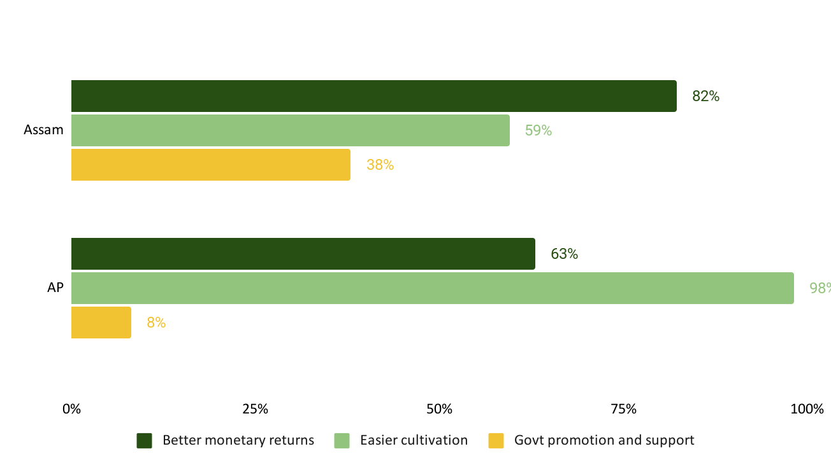
Reason for Growing Oil Palm I Farmers have started growing oil palm largely due to the high monetary returns associated with the crop, and ease of cultivation- it requires minimal effort as compared to other cash crops like rubber and areca nut
71%
farmers have taken up oil palm due to better monetary returns
82%
of farmers have started growing oil palm due to easier cultivation
21%
farmers have taken up oil palm due to promotion and support by Govt
“
“
Reasons for growing oil palm: Assam and AP
We started oil palm to obtain good profit, we have been growing since 6 years and it has given us good profits till now.. We hope to expand the plantation…
Farmer (F, 65), Goalpara, Assam (member- Mili Juli Group)
(n=78)
“
“
“
“
(n=111)
We are cultivating oil palm since the time we migrated from Godavari in search of livelihood. It has been 15 years and our main source of income is through farming.
Farmer (M, 62), Srikakulam, Andhra Pradesh
% of Farmers in both states
“
Source: Primary Interviews across AP and Assam, Sattva Analysis
Notes:
What were the farmers previously growing before oil palm and currently growing along with oil palm? Intra and inter state differences?

Slide 20
Nature of Plantation and Farming Practices I Primary research conducted by Sattva among the smallholder farmers have provided insights across various farming practices
Land use for Plantations
Seedling Variety
Irrigation
Nature of land used
Ownership of land, availability of land titles
Volume/Share of land allocated to oil palm
Seedling variety and source of seedlings
Planting season
Cost incurred on seedlings
Source of water
Mode of irrigation
Cost incurred on irrigation
Fertilizer
Energy
Labour
Type of fertilizer used
Cost incurred on fertilizer
Source and use of energy
Cost incurred on energy
Source of labour
Activities undertaken by labour
Cost incurred on labour
Detailed insights across these six areas have been covered in Annexure 2
Notes:
What are the farming practices in terms of seed?

Slide 21
Harvesting and Yield | Andhra Pradesh reported more than double the harvest times and ~8 times per acre yield as compared to Assam
Assam (Goalpara)
Andhra Pradesh
9
Times
Average number of harvests per year, with the reported range being 2-16 harvests per year
22
Times
Average number of harvests per year, with the reported range being 6-24 harvests per year
2,976
kgs
Average yield in a year per hectare* ranging from 903 kgs to 6502 kgs
19,536
kgs
Average yield in a year per hectare** ranging from 568 kgs to 37,065 kgs
94%
Farmers reported increase in yield since previous year (N=32)
9%
Farmers reported increase in yield since previous year (N=78)
The farmers are not able to harvest the FFBs all year round due to reliance on only rainwater for irrigation. Poor farm management and lack of irrigation results in lower overall productivity of plantations in the state.
The average per hectare yield in a year is highest in West Godavari (19,296 kgs) and the lowest in Srikakulam (12,117 kgs), which may be attributed to the presence of more mature farmers in West Godavari (> 7 years).
Andhra Pradesh leads in terms of productivity owing to good plantation management practices. Interestingly, while the farmers in Assam are reporting a YoY increase in yield from plantations, plantations in AP have reached maturity leading to a stagnation in YoY growth in yield.
*Calculated from the optimized data of 17 out of 32 farmers in Goalpara, Assam who are harvesting. The yield was optimized based on the reported revenue, price per kg, average yield and land size
**Calculated from the optimized data of 54 out of 78 farmers in Andhra Pradesh, who have been growing oil palm for more than > 4 years
Notes:
There are a lot of monthly variations in yield. First might be good and second might be less. Variations based on age of tree - >15 years have better farmers variations will have better produce

Slide 22
Income from Oil Palm | Oil Palm is a major source of income for smallholders in Andhra Pradesh but hasn’t acquired the status of the key cash crop in Assam yet
Assam (Goalpara)
Andhra Pradesh
100%
Farmers reported increase in income since previous year (N=32)
9%
Farmers reported increase in income since previous year (N=78)
Rs 45,181
Average revenue in a year per hectare* ranging from Rs 7,225 to Rs 138,723
Rs 236,276
Average revenue in a year per hectare** ranging from Rs 6,252 to Rs 426,248
Rs 34,087
Average cost in a year per hectare* ranging from Rs. 1,376 to Rs. 45,113
(2 people reported Rs 0)
Rs 90,982
Average cost in a year per hectare** ranging from Rs 988 to Rs 225,602
(2 people reported Rs 0)
Rs 11,094
Estimated average income in a year per hectare
Rs 145,294
Estimated average income in a year per hectare
Revenue from oil palm is not a primary source of income from agriculture in Assam as 65% farmers reported that the revenue from oil palm contributes to less than 60% of their total agricultural revenue
The average reported income from oil palm is Rs 101,624 per hectare (N=47), ranging from Rs 2,471 to Rs 14.82 lakh per hectare. Hence, there is some underreporting/misreporting of income by respondents. While the overall data on income is not reliable in Andhra Pradesh, it is clear that oil palm is one of the major sources of overall income among coconut, cotton etc but no one is relying entirely on it.
There is a significant difference between the investment and return on oil palm each season in both the states. Due to this, there is also a 10X difference in average profit / income. However, since the crop is in growth phase in Assam, farmers are seeing a YoY increase in income, whereas the income growth in Andhra Pradesh seems to have stagnated.
*Based on the optimized data of 17 out of 32 farmers in Goalpara, Assam who are harvesting. The yield was optimized based on the reported revenue, price per kg, average yield and land size
**Calculated by multiplying the optimized yield data and reported prices of 53 out of 78 farmers in Andhra Pradesh, who have been growing oil palm for more than > 4 years
Notes:
What are the farming practices in terms of seed?

Slide 23
Institutional Support and Market Linkages

Slide 24
Oil Palm Landscape on the Ground | Other than farmers, the nature and roles of key players vary in Assam (nascent market) and Andhra Pradesh (mature market)
Organization formed by farmers which provides for sharing of costs and profits/benefits among the members*
Government
Farmer Producer Organizations
Market Players
Assam | State Agriculture Department | 1. Farmer Associations - Oil Palm Growers Coordination Committee, RHAC have been pivotal in introduction of oil palm in the state, and are responsible for facilitating transport and sales to the local collection centre. 2. Farmer groups - Manabashi, Mili Juli, facilitate collective transportation till the collection centre and cost sharing; awareness on schemes and subsidies; peer to peer learning. | 1. Trading Companies - Shivasais is the only trading company purchasing oil palm FFBs from farmers in Goalpara. It had also facilitated setting up of a nursery for seedlings. 2. Large corporates (NMEO-OP)- Starting oil palm cultivation in other sectors by selecting farmers, getting approval from nodal agencies, and providing farmers with seedlings and training.
Andhra Pradesh | State Horticulture Department | Limited FPOs in Andhra Pradesh with some found in West Godavari | 1. Local Private / Government Mills - Purchase FFBs from farmers and then trade them further in the open market. 2. Large Corporates (NMEO-OP) - Run collection centres and processing units where farmers can sell their FFBs. They are also trying to provide training and inputs to farmers through the NMEO-OP subsidies and guidelines.
Implement NMEO-OP and other farmer welfare schemes in coordination with allocated corporates
Identifying farmers interested in growing oil palm and assessing suitability of the land
Provide subsidies for intercropping, fertilizers, maintenance of farm and fertilizers, seeds etc
Participate in training of farmers and providing them information along with the other market players
*Farmers Producer Organisation (FPO)
Notes:
Ranges to show overall how much land is being used
District wise = % average and ranges – % of land allocated for oil palm - insights on the farmer priorities and the perceived value of oil palm as a commercial crop
What is the average landholding size in both states? - represent using a column graph that has range of average landholding size?
Are farmers using their own land/or leased/common land for growing oil palm? Inter and intra-state variations. Is the nature of land rights customary or legally registered? Highlight any challenges in farmers obtaining ownership or land rights?- represent using bar graph?

Slide 25
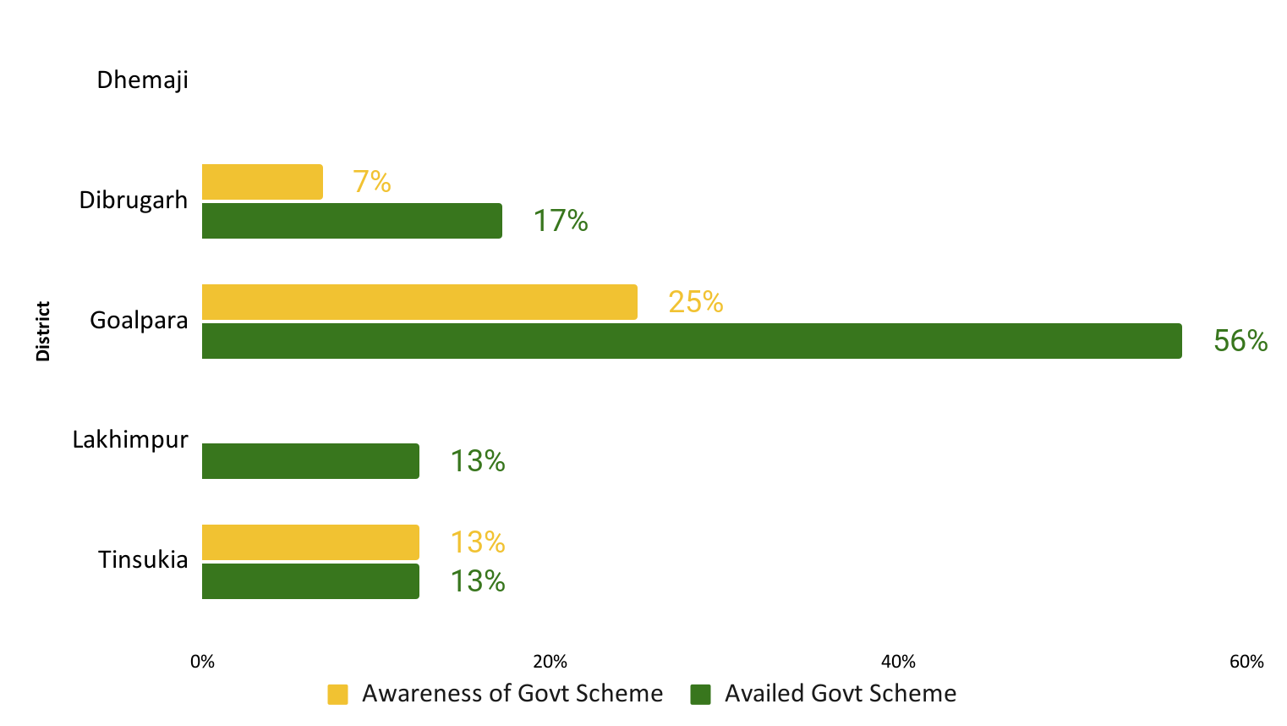
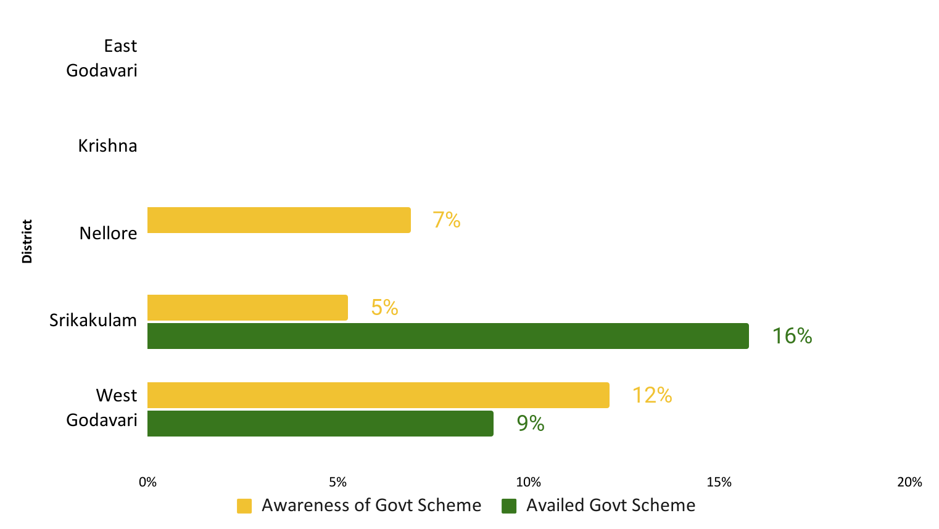
Government Support | There is low awareness of and assistance from government schemes across farmers in both the states, leading to lack of support and interest respectively
Assam
Andhra Pradesh
14% farmers receive regular information, mainly from the agri dept, and 32% receive assistance from the government schemes, largely in Goalpara. Information dissemination regarding technical knowhow and practices is sporadic post cultivation in Goalpara. Cultivation is very nascent in other districts to comment.
6% farmers receive regular information and 5% receive assistance from the government schemes, largely due to dependence on corporates. Despite multiple schemes for farmers, follow up assistance, information dissemination and training is very low.
N=78
N=111
Govt: District / state agriculture office, Panchayat secretary, Krishi Vikas Kendras (KVK)
FPO: Oil Palm Grower Coordination Committee
Govt: District horticulture department (sits in the village secretariat i.e. sachivalayam)
Rythu Bharosa Kendram: One stop shop for govt certified agri inputs with attached workshops and knowledge centres
Corporations: Field staff
Farmers perceive low awareness and access to schemes and technical knowhow across both the states due to challenges such as limited direct delivery of interventions, low reach and benefit of on-ground programs, as well as administrative issues that lead to delays in release of financial assistance or incentives to farmers.
Source: Primary Interviews across AP and Assam, Sattva Analysis
Notes:
Ranges to show overall how much land is being used
District wise = % average and ranges – % of land allocated for oil palm - insights on the farmer priorities and the perceived value of oil palm as a commercial crop
What is the average landholding size in both states? - represent using a column graph that has range of average landholding size?
Are farmers using their own land/or leased/common land for growing oil palm? Inter and intra-state variations. Is the nature of land rights customary or legally registered? Highlight any challenges in farmers obtaining ownership or land rights?- represent using bar graph?

Slide 26
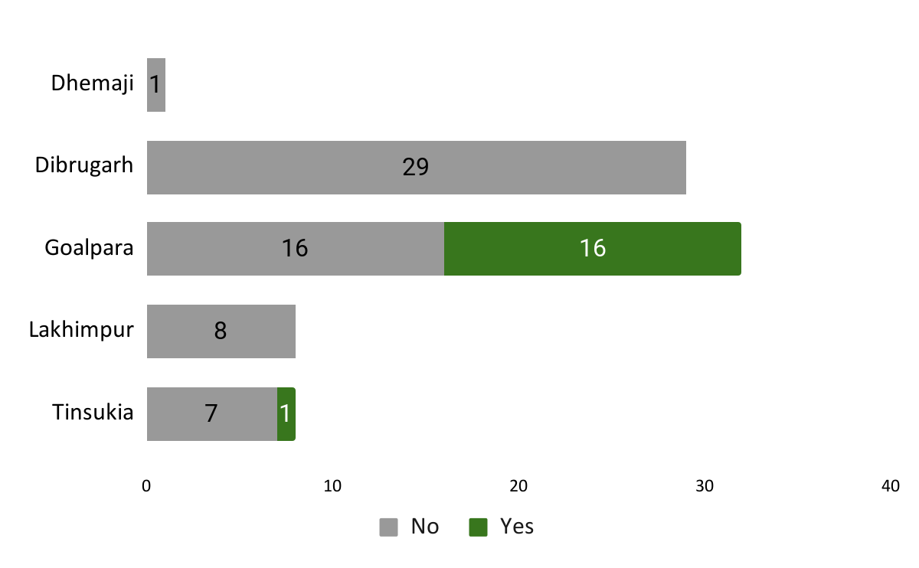
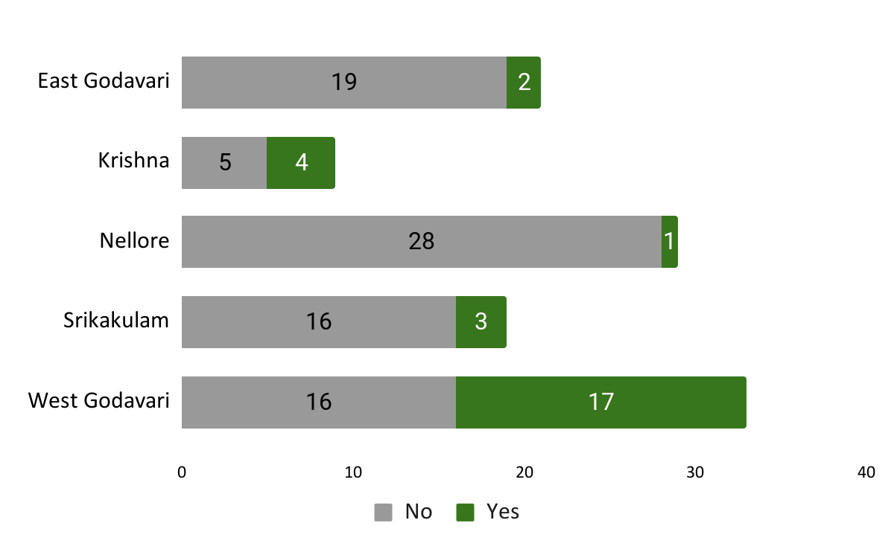
Participation in farmer groups|There are few FPOs in both Andhra Pradesh and Assam which leads to limited awareness and dependence on corporates among farmers
Assam
Andhra Pradesh
N=78
N=111
FPOs are largely present in Goalpara, where the farmers are mature and involved in sale of FFBs. Farmers are usually associated with one or both of these:
Registered FPOs having 25-100+ members (Manabashi, Mili Juli, Banabashi etc)
Cooperatives facilitating collection and sales of the produce and providing farmers with technical assistance (RHAC, Oil Palm Grower Coordination Committee)
Despite Andhra Pradesh being a mature market, Sattva did not come across any oil palm FPOs. In fact, farmers in East Godavari reported a lower need for FPOs due to corporate involvement across the value chain.
While larger, more influential farmers cited they do not need FPOs, smaller farmers who may lack regular government and corporate support in accessing information and training on farming practices, cited a need for FPOs and organization.
In Eluru (earlier West Godavari), government supported the farmers in forming FPOs*
In both the states, the prevalent trend of lower association among farmers might be a challenge in implementing the RSPO standards and providing certifications to groups. However, it was seen that farmers who organized themselves benefit due to better awareness and collaboration
Source: Primary Interviews across AP and Assam, Sattva Analysis
* The FPOs in Eluru were formed under a Central Sector Scheme,, please refer to the annexure for more information

Slide 27
Market Linkages – Assam | Most farmers are unsure of who they are selling to and are not receiving the MSP of Rs 9.80 per kg* in Goalpara
In Assam, only Goalpara has mature plantations (>4 yrs) where oil palm FFBs are being harvested, ~100% of farmers sell their produce through two routes, N=31
Source
 | Primary Research |  | Secondary Research
Route 1
(69% farmers)
Farmers receive Rs 8 per kg
Notes:
1. The farmers do not register themselves with Shivasis at any stage. Since it is the only large trading company procuring from Goalpara, the farmers sell to Shivasis**.
2. Mode of payment: Shivasis pays the farmers through bank accounts, within 7-10 days, however local intermediaries and traders practice immediate cash payouts, prompting some farmers to choose selling to them.
Sell directly to the trading company obtaining a uniform price for all farmers each season
50% farmers are associated with an FPO
95% farmers reported self transportation till the collection centre
Farmer
Trading Company
(Shivasis)
Processing unit
Open Market
Route 2
(31% farmers)
Local trader / intermediary
Shivasais transports the the produce to Mizoram for processing at Godrej owned mill
MNCs who trade in and use palm oil (eg. Cargill, Cofcan, etc)
Smaller domestic users of oil palm like local restaurants and food producers (e.g. Haldiram, Bikanervala)
Sell to company through local traders and intermediaries, often at lower than fixed prices
Farmers receive a price between Rs 7 - Rs 7.80 per kg or don’t know
64% farmers reported self transportation, remaining said buyer or FPO takes care of it
45% farmers are associated with an FPO
Farmers have to pay for their own transportation costs, FPOs enhance access to transportation and arrangement of transport as well as cost sharing for transportation but does not bear the cost for each member farmer
The absence of a formal procurer assigned by the govt, and legal issues in Goalpara has led to one trading company buying most of the produce, with a number of intermediaries or middlemen existing as well. During FGDs, farmers reported receiving as less as Rs 5 per kg, leading to lack of motivation to continue with oil palm.
*The MSP fixed by the government is Rs 9,830.29 / MT as per the notification dated September, 2023;
**Shivasis started procuring from Goalpara due to the initiative taken by Rabha Hasong Autonomous Council (RHAC) that was instrumental in starting Palm Cultivation in the region
Notes:
Insight-
The absence of a formal procurer assigned by the govt, and legal issues in Goalpara has led to one trading company buying most of the produce, with a number of intermediaries or middlemen existing as well. Farmers who sell to the trading co directly receive a higher price compared to farmers selling to intermediaries, however all farmers have received prices below the state determined MSP- ? check something on these lines @diya

Slide 28
Market Linkages – Andhra Pradesh | While the market is more mature, it is highly regulated based on NMEO-OP and Oil Palm Act, 1993
In Andhra Pradesh, 91% of farmers across five districts sell their produce. Since it is a mature market the routes are well structured with the growers selling to nearby private or government mills, N=111
Farmer
Processing unit
Refineries
Market
Source
 | Primary Research |  | Secondary Research
Collection centres
There are 13 processing units with a total crushing capacity of 461 MT FFB per hour, ranging from 5 to 125 MT FFB per hour
Since most of the large corporates are vertically integrated, the crude oil is sent for further refining and sales in other states
Users of palm oil and palm kernel oil
Farmers selling to allocated corporates reported that they are reimbursed the transportation cost only if they drop the produce at their processing unit
100% of the farmers reported self transportation.
District | Price (per kg)* | Registration
East Godavari N=21 | Rs 11 - Rs 16, Average price Rs 12.11 | 29%
Krishna N=9 | Rs 12 - Rs 12.40, Average price Rs 12.10 | 78%
Nellore N=29 | Rs 12 - Rs 12.40 Average Price Rs 12.34 | 52%
Srikakulam N=19 | Rs 11 - Rs 12.40 Average Price Rs 11.65 | 74%
West Godavari N=33 | Rs 11 - Rs 12.50 Average Price Rs 12.11 | 82%
There are no large variations in the per kg price reported across districts, with the overall average being Rs 12.12. The market is well structured with both large and small mills having allocated regions for procurement. The variation is price is assumed to be because of the fluctuating rates of oil palm across the months.
Majority of farmers reported registering** with buyers (either formally or informally), especially in Krishna, Srikakulam and Nellore. This registration also facilitates direct account transfer of the price to the farmers when they sell their harvest to the company. However, the farmers are not obligated to sell to these buyers.
*The MSP fixed by the government is Rs 12,493 / MT as per the notification dated June, 2023
**The farmers register with corporates by providing their bank details and the corporate provides them with inputs in return.
Notes:
The corporates may not provide sufficient inputs so farmers also get them from other markets

Slide 29
Emerging Archetypes, Key Constraints and Recommendations

Slide 30
Specific recommendations have been customised by identification of the most pressing constraints impacting the different stakeholder archetypes and sub-archetypes
Archetypes and Sub-archetypes
Constraint Mapping and Prioritization
Recommendations and Interventions
Segmentation of farmers based on different characteristic determinants can allow in-depth constraint identification. Segmentation and sub-segmentation has been conducted based on:
Inter-state differences: Farmers in Assam and AP have different needs, and constraints owing to different policy atmosphere and implementation modes, differential market maturity wrt oil palm processing
Inter-stage differences: Farmers in gestation period differ from farmers that have started harvesting FFBs, and even within the later group there are differences within farmers who have harvested the crop for less than 5 years versus others
Constraints specific to the palm oil value chain have been identified and mapped based on severity for each sub-archetype and archetype of farmers.
Each constraint has been assigned high/med/low severity for each archetype based on their level of impact on the farmers, followed by assigning of a composite high/low/med scoring for each constraint at a state level. Further each constraint has been evaluated on the basis of:
Impact on sustainability: What is the sustainability implications of the particular constraint, and how can interventions solve for challenges?
Impact of Policy landscape: Is the current policy landscape addressing or aggravating the constraint in any manner?
Specific recommendations and actionable intervention strategies have been proposed and evaluated across the following parameters:
Impact on yield: Will the intervention lead to yield improvement for farmers in the short/med/long term?
Impact on income: Will the intervention lead to income improvement for smallholders?
Ease of Implementation: Is RSPO well-placed to implement the intervention given their current presence in the ecosystem?
Farmer readiness has been mapped based on specific parameters which are important from an RSPO perspective for the implementation of interventions.
Each intervention strategy has been detailed out within the Short-Med-Long term timeframe highlighting activities, enablers and considerations.

Slide 31
Farmer Archetypes I The archetypes have been created based on geography and maturity of farmers as these are key differentiating factors while mapping constraints
Assam
Andhra-Pradesh
The government is promoting oil palm cultivation in Assam with large-scale plantation project initiated by the state government, this underscores the need to understand the implications of such initiatives on the environment and local communities. Studying oil palm cultivation in Assam is crucial to balance economic development with environmental sustainability and to make informed decisions regarding agricultural practices in the region.
Since AP is a mature market with oil palm cultivation starting from early 2000s, the concerns related to environmental protection, and socio-economic welfare manifest differently here as compared to Assam. Identifying obstacles such as low productivity, price fluctuations, insufficient processing facilities, and lack of suitable technologies will help develop strategies to overcome them
1
2
3
1
2
3
Farmers in Gestation Period
Farmers Harvesting
<5 years
Farmers Harvesting
>5 years
Farmers in Gestation Period
Farmers Harvesting
<5 years
Farmers Harvesting
>5 years
The sub-archetyping of farmers is done based on the maturity level of plantations, which is a key determinant of constraints and opportunities due to the variation in inputs access and utilization along with on-farm activities across various stages of production and maturity.

Slide 32
Archetype Characteristics I These characteristics allowed in developing a deeper understanding of challenges and support required to overcome them for each archetype
Assam
Andhra-Pradesh
Farmers in Gestation Period
Farmers Harvesting
<5 years
Farmers Harvesting
>5 years
Farmers in Gestation Period
Farmers Harvesting
<5 years
Farmers Harvesting
>5 years
Age
64% Farmers are in the age group of 35-50 yrs | 39% Farmers are in the age group of 35-50 yrs | 75% Farmers are in the age group of 35-50
51% Farmers have studied below class 10th | 57% Farmers have studied below class 10th | 75% Farmers have studied below class 10th
1.3 Ha average landholding | 1 Ha average landholding | 1.4 Ha average landholding
48% Of the total land is being used for oil palm | 68% Of the total land is being used for oil palm | 96% Of the total land is being used for oil palm
66% Farmers belong to OBC category | 91% Farmers belong to general category | 88% Farmers belong to ST community
48% Farmers are in the age group of 35-50 & >50 yrs | 54% Farmers are in the age group of >50 yrs | 60% Farmers are in the age group of >50 yrs
30% Farmers are illiterate and 30% are graduate | 52% Farmers are illiterate | 40% Farmers are illiterate
2.7 Ha average landholding | 3.5 Ha average landholding | 4 Ha average landholding
96% Of the total land is being used for oil palm | 100% Of the total land is being used for oil palm | 91% Of the total land is being used for oil palm
70% Farmers belong to general category | 81% Farmers belong to general category | 78% Farmers belong to general category
Education
Land used for oil palm
Average % the total land
Category

Slide 33
Constraints I Primary research among smallholder farmers has shed light on constraints faced by farmers across the value chain
Division of value chain based on inputs utilisation at different stages of production
Specific constraints
This stage refers to the initial phase of planning and preparation of the land for planting the oil palm trees by adding the critical inputs like setting irrigation facilities, testing soil quality, etc. The lack of availability and accessibility of these inputs directly impacts farmer income and plantation yield, highlighting the need for interventions to address this constraint.
Lack of proper use and application of fertilizer
Lack of access to free seeds and saplings in AP
Inaccessibility of soil testing facility in both the states
Limited irrigation facilities
Unavailability of land titles to farmers in Assam
Pre-farm
This stage includes activities such as planting, maintaining, and harvesting the oil palm trees. It also involves the management of pests, diseases, and weeds, as well as the application of inputs to ensure optimal growth and productivity of the oil palm trees.
Incurring high cost of labour
Inability to have the formation of cooperatives / FPOs
Negative impact of disease infestation, human-animal conflict
Unawareness regarding the benefits of intercropping & govt subsidies
On-farm
The post-farm stage in the cultivation of oil palm refers to activities that take place after the oil palm fruits have been harvested from the plantation. Other activities in the post-farm stage may include waste management, maintenance of equipment, and farm infrastructure.
Inability to get govt determined prices for oil palm
Lack of transportation facilities
Lack of processing units
Post-farm
Based on these constraints, RSPO can play a key role in enabling farmers’ access to higher incomes and better markets, the next slides seek to answer the following questions:
What are the various interventions that RSPO can implement or facilitate to enable high-value linkages?
Which interventions are likely to provide the highest returns or impact with respect to improving farmer earnings/yield?
How feasible and sustainable are these interventions in the long run, given the socio-economic context of the farmers and other value chain actors?
What skills, knowledge and resources does RSPO have and/or need to implement these interventions?
What external challenges and barriers does RSPO need to address to ensure the success of the interventions?

Slide 34
Constraints: Pre-farm I Farmers face constraints related to accessing proper inputs and in determining appropriate application rate and techniques for the specific inputs
Constraint | Severity in AP | Severity in Assam
Fertilizer
Soil Quality
Land Rights
Irrigation
High and Medium Severity Constraints
Access to inputs
Fertilizers:
All the farmers in gestation period in Assam use less than 5 fertilizers essential for palm oil production.
Farmers lack information on oil palm fertilizer requirements, while those without land titles are unable to access government subsidies for fertilizers.
Fertilizers are used excessively in AP with 80% farmers using more than 8 fertilizers
Irrigation:
In Assam the farmers are entirely dependent on rainfall for irrigation as the state receives abundant rainfall. 83% farmers in gestation period don’t have access to irrigation systems
Farmers in AP depend entirely on groundwater leading to over utilisation.
Soil Quality
There is an inability / unawareness to avail the oil testing facility by farmers in both the states which hinders farmers from making informed decisions about their farming practices.
9 out of 10 farmers in Assam and 5 out of 10 farmers in AP in the gestation period don’t have avail the soil testing facility which can significantly boost productivity by guiding informed decisions on fertilizer use, crop selection, and soil management.
Since the fertilizer usage is not done optimally in AP there is a sustainability implication which in turn degrades the soil quality
Access to Land
26% farmers in Assam harvesting for less than 5 years don’t have ownership to land they grow oil palm.
Farmers in Assam without land titles are unable to access government subsidies and support for agricultural inputs, including fertilizers and equipment, which are essential for oil palm cultivation.
According to the recently passed amendments to the Forest (Conservation) Act, deemed forests that weren’t under protection according to the Indian Forest Act, 1927, can be used for non-forest activities potentially driving vast oil palm plantations.¹
High
Medium
Low
More farmers in Assam are impacted by pre-farm challenges as compared to AP. However some challenges like access to soil testing is a constraint impacting farmers across both states.
The farmers in Assam face a higher number of severe constraints as compared to farmers in AP. In Assam as well as AP farmers have limited information availability and trainings on farm management and sustainability which directly impacts their income and yield and has implication on farm sustainability. Thus, information dissemination on best practices and sustainable oil palm cultivation is a necessity for the farmers.
1. Oil palm plantations proved to be a disaster in Mizoram — is Assam next?
Notes:
(need to promote drip irrigation in AP, provide access to irrigation in Assam/facilitate subsidies for lean months)

Slide 35
Constraints: On-farm I Farmers face constraints related to accessing proper inputs and in determining appropriate application rate and techniques for the specific inputs
Constraint | Severity in AP | Severity in Assam
Disease Infestation
Extension services
Human animal conflict
High and Medium Severity Constraints
Disease Infestation
Over 60% of farmers in AP have suffered from disease infestation in their plantations, farmers also complained of rodent infestation, and lack technical knowledge to manage the same effectively. Common diseases include rot in leaves, rot in FFBs, coconut palm beetles.
Farmers in Assam are not majorly impacted by pest attacks, however few farmers reported termites, rodents small birds (bulbul) attacking trees. Farmers in Assam also lack knowledge on appropriate pesticides.
Sustainability issues arise from unregulated pesticide, poor knowledge dissemination causing soil and water pollution, harm to non-target species and pest resistance.
Extension services
Farmers in AP have low awareness of govt schemes and face challenges in accessing extension services due to sole reliance on Corporates/processors for all information.
Farmers in Goalpara, Assam receive information from Farmer leaders/influential farmers, and KVKs, corporates actively in other districts.
The NMEO-OP scheme directs the processor assigned to an area to take up training and knowledge sharing activities for all oil palm farmers of the area, however implementation of the same is poor.
Human Animal conflict
Farmers in Assam face challenges arising from Human Animal conflict, specially farmers in the gestation period increasingly reported this (51%) due to a number of plantations lying close to elephant corridors and pathways.
Elephant attacks are uncommon in AP, however some districts like Krishna and Srikakulam face irregular disruption from elephants occasionally.
Land conversions for plantations, including palm besides others like areca nut, rubber etc have led to destruction of forests and habitats, leading to more frequent human animal interactions and conflicts.
High
Medium
Low
More farmers in AP are impacted by on-farm challenges as compared to AP. Specifically some challenges like disease infestation and lack of extension services are interrelated and reflect gaps in policy implementation and stakeholder collaboration.
The farmers in AP face a higher number of severe constraints as compared to farmers in Assam. In Assam as well as AP farmers have limited information availability and trainings on farm management and sustainability which directly impacts their income and yield and has implication on farm sustainability.

Slide 36
Constraints: On-farm I Farmers face constraints related to accessing proper inputs and in determining appropriate application rate and techniques for the specific inputs
Constraint | Severity in AP | Severity in Assam
Intercropping
Cooperatives & FPOs
Climate events
High and Medium Severity Constraints
Intercropping
Farmers in AP are reluctant to pursue intercropping with ~100% of farmers in harvesting stage not intercropping and only 17% in the gestation period intercropping.
Farmers cited oil palm tree’s resource dependence and shade as hindrances to successful intercropping.
Monoculture leads to high vulnerability from crop failure and depletion of soil nutrients, biodiversity loss.
Farmers also fail to realize full potential of subsidies for not availing intercropping subsidy.
Cooperatives & FPOs
Assam, specially Goalpara has presence of some oil palm specific farmer groups but FPOs interactions were minimal in other locations.
Over 80% of farmers in gestation stage and harvesting <5 yrs are not associated with FPOs. In AP, absence of FPOs is due to large size of individual plantations and farmers trying to secure individual profits by directly working with the processing companies.
Absence of FPOs leads to increased dependence on corporates for information, lack of cost sharing, bargaining.
Farmers cited need for FPOs for greater awareness and learning and lower dependencies on corporates.
Climate events
Over 1 in 2 farmers in AP is impacted by changing climate conditions and weather patterns.
Drought and erratic rainfall patterns are the most common manifestation of climate change in AP, leading to farmers facing challenges in obtaining water for irrigation, and extreme reliance on groundwater, which further pushes down water tables and aggravates drought conditions.
High
Medium
Low
More farmers in AP are impacted by on-farm challenges as compared to AP. However some challenges like absence of cooperatives and farmer associations is a constraint impacting farmers across both states.
The farmers in AP face a higher number of severe constraints as compared to farmers in Assam. In Assam as well as AP farmers have limited information availability and trainings on farm management and sustainability which directly impacts their income and yield and has implication on farm sustainability.

Slide 37
Constraints: Post farm I Post farm constraints are largely centered around accessing proper markets and supporting infrastructure, which is emerges significantly as a challenge in Assam
High and Medium Severity Constraints
Constraint | Severity in AP | Severity in Assam
Price
Transport- ation
Supporting Infrastructure
Price
Almost 9 out of 10 farmers harvesting FFBs in Assam do not receive the NMEO-OP assured price for their produce
Absence of a government assigned buyer and legal complexities in Goalpara has led to one trader dominating the market, operating alongside several middlemen.
Contrastingly, only 1 out of 10 farmers in Andhra Pradesh reported not receiving the NMEO-OP price, which may be attributed to the fluctuations in monthly rates of oil palm based on the international crude oil prices.
Transportation
Almost 9 out of 10 farmers harvesting FFBs in Assam are not reimbursed for transportation (as specified in the policy). However, some farmers are assisted by FPOs and associations in transportation which reduces their individual costs.
While there is an MOU between Assam govt and Shivasais in Goalpara, there are challenges in implementation leading to lack of visibility on the transportation reimbursement policies, prices paid etc
Supporting Infrastructure
Assam does not have any mills yet leading to long transportation distances affecting the quality of the perishable FFBs. The nearest mill is in Mizoram
There are 13 processing units in AP with a total crushing capacity of 461 MT FFB per hour, ranging from 5 to 125 MT FFB per hour
High
Medium
Low
Assam being a nascent market is more affected by post farm constraints in terms of inadequate pricing, high transportation costs, and lack of supporting infrastructure.
The Goalpara district in Assam must resolve the legal issues to ensure farmers are receiving a fair price for their produce and are incentivised to continue oil palm cultivation. A larger risk is that the dissatisfaction among these farmers can lead to lack of interest in other farmers as well making adoption difficult.

Slide 38
Farmer Readiness|Based on the eligibility and milestone parameters of the RSPO ISH Certification, farmers in both states display a low readiness for obtaining the certification
Current Level of Readiness for RSPO SH Certification
Land Legality
Nature of Land
Organization into Groups
Willingness
Women Participation
Risk of Child Labour
Fertilizers
Irrigation
68% Farmers don’t have patta / contracts for the land they are currently using for plantations | 81% Land used for oil palm is arable agri land, remaining being forest and common land | 78% Farmers are not part of FPOs/ Cooperatives or other farmer groups | 85% Farmers were willing to know and adopt RSPO certification | 11% Women landowning farmers | Not prevalent | 96% Farmers use less than 5 types of fertilizers | 80% Farmers use rainwater for irrigation
100% Landowners have papers for their land | 100% Land used for oil palm is arable agri land | 76% Farmers are not part of FPOs/ Cooperatives or other farmer groups | 17% Farmers were willing to know and adopt RSPO certification | 2% Women landowning farmers |  | 49% Farmers use more than 8 types of fertilizers | 100% Farmers use groundwater for irrigation
Assam
AP
Based on these parameters of farmer readiness, farmers in Andhra Pradesh are more prepared but less willing for ISH certification as compared than farmers in Assam. A three pronged strategy has been proposed for RSPO to solve for these challenges as well as increase readiness of farmers for certification.

Slide 39
Needs and Interventions|Sattva proposes the following actionable intervention strategies to meet needs of farmers and ecosystem stakeholders
A. Ecosystem Engagement
B. Smallholder Training
C. Certification Process
Improve coordination within the ecosystem actors and promote sustainable oil palm
Training farmers on technical and management components related to oil palm cultivation
Ensuring palm oil cultivation is sustainable, responsible and profitable for all the entities involved
Lack of access to free seeds and saplings in AP Unavailability of land titles to farmers in Assam Limited irrigation facilities | Inaccessibility / unawareness of soil testing facility Lack of proper use and application of fertilizers | Use of biodiversity rich land and high conservation areas for cultivation (e.g. forest and common lands in Assam)
Lack of awareness and access to government schemes (e.g. intercropping, planting, seeds ) Vulnerability to manifestation of climate change | Unawareness around benefits of intercropping and proper farm management Prevalence of disease infestation High cost incurred on labour | Managing human-wildlife interactions within plantations Inability to have the formation of cooperatives / FPOs
Access to govt assured prices and viability price Access to transportation / reimbursement Lack of processing units / refineries | Med-high cost incurred on labour (need to bring in light mechanization for particular stages- harvesting) Lack of awareness of existing and assigned buyers | Lack of access to market (can be facilitated for CSPO through RSPO credits) Lack of record keeping at farmer level Declining prices in AP over the years (premium)
Pre Farm
On Farm
Farmer Constraints
Post Farm
Ecosystem engagement will create greater synergies between all the players to solve current ecosystem challenges, such as excess saplings within corporate nurseries, ineligibility of land for oil palm cultivation (due to lack of land titles), viability of setting up new processing units etc.
Training farmers will result in better quality of yield (FFBs) from plantations. Further, multi-stakeholder collaboration shall ensure the training modules encourage productivity and sustainability, while being relevant for the different contexts in which farmers operate.
The process for achieving the certification will lead to responsible cultivation, benefiting all the stakeholders. It can prevent plantations in unfavourable areas- among dense vegetation, which may be difficult to manage, produce low quality FFBs and face greater issues related to connectivity.
Relevance for Other Stakeholders

Slide 40
Intervention Pathways | Based on the impact and ease of implementation of the interventions, RSPO can prioritize Ecosystem Engagement and Smallholder Trainings
Ease of Implementation
Intervention Pathway |  | Details | Impact on Productivity | Impact on Income | Assam | Andhra Pradesh
A | Ecosystem Engagement | Facilitate workshops and one-on-one engagements for greater alignment between the ecosystem stakeholder and working together | Yes | Yes | High Strong relationship with relevant stakeholders i.e. government, corporates, and farmers | Medium In the process of strengthening their presence and involvement in the ecosystem, especially with the government
B | Smallholder Trainings | Ensure training of farmers on technical and management components of oil palm cultivation | Yes | Yes
C | Certification | Encourage and facilitate sustainable oil palm production among farmers and other stakeholders | No | Yes | Low Majority of the farmers do not have land titles and are not part of existing farmer groups | Medium Farmers are not associated with groups and are currently lack interest in certifications

Slide 41
Strategy for RSPO| All the interventions are interlinked and have to be implemented together over a period of time for maximum effectiveness
Interventions
Short (0-6 months)
Medium (6-12 months)
Long-term (1-2 years)
Conduct multi-stakeholder workshop across the two states to disseminate information gathered from landscape study | 1:1 meetings with corporates to and workshops with farmers at a village / district level to collaborate for sustainable oil palm cultivation | Scaling up workshops to promote sustainability in other oil palm growing states
Identify archetypes of potential master trainers for each state and company | Identifying and training master trainers to deliver updated / RSPO inclusive modules to farmers | Connect master trainers with farmer groups
Communicate about certification and need for sustainable palm oil to build interest across stakeholders (through workshops) | Creating farmer groups, legally registering them, and appointing group managers in preparation for ISH Certification | Supporting smallholders and processors in getting the certification through RSSF and RSEP
Ecosystem Engagement
Smallholder Training
Certification Process

Slide 42
Intervention A: Ecosystem Engagement
Timeline | Short term | Medium term | Long term
Target Audience | Processing Industry and Market players, Government stakeholders, Research organizations, NGOs, Smallholder farmer Representatives
Objectives / Goals | To conduct workshop with key stakeholders in Assam and Andhra Pradesh | To secure buy in from processing companies to move towards sustainable oil palm cultivation | To scale ecosystem engagement across different oil palm growing states in India
RSPO's R&R and Activities | Outreach to participants and buy in Design workshop interaction materials Alignment on roles and support from workshop stakeholders to boost sustainable production of oil palm | Post workshop engagement and monitoring progress with stakeholders Aligning the companies’ training SOPs with national and environmental guidelines Enter into an agreements and collaboration for sustainable oil palm cultivation | Identify avenues for engaging in other states where need for sustainability within oil palm emerges strongly. Eg. Mizoram, Arunachal Pradesh, A&N Islands
 |  | Engage with other players trying to promote and operationalize use of sustainable palm oil in India (e.g. IDH) Provide policy recommendations and push for State Level policy regulating Oil Palm production in Assam
Enablers / Anchors | Govt Stakeholders- Nodal officers (Agri & Horti Dept of States), Central Govt rep Processing Companies- Plantation Officers, Agri Departments, Procurement Heads Smallholders- Farmer leaders, FPO members/leaders Academia- SPoCs from research organizations, NGOs
Key Considerations | Participation: Ensuring equal participation of all stakeholder groups Reaching consensus: Alignment of stakeholder goals and creation of synergies between varying stakeholder expectations | Advocacy: Emphasis on the existing and potential integration of sustainable practices within the regulatory landscape | Sustainability in India: Building a common understanding of sustainable practices in the Indian context among government stakeholders, farmers, corporates and academia
Outcomes | Defined pathways for collaboration between stakeholders to solve for farmer constraints and ecosystem challenges | Increased adoption of sustainable cultivation practices among farmers | Increased interest in sustainable palm oil production among the industry and farmers

Slide 43
Intervention B: Smallholder Training
Timeline | Short term | Medium term | Long term
Target Audience | Integrated entity-grower and processing units/mills, Plantations, Mills, Organized and Independent Smallholders
Objectives | To identify all relevant stakeholders for training purposes, potential master trainers and cover a broad spectrum of individuals involved in the palm oil industry. | To provide training and guidance to master trainers while sensitising them regarding sustainability challenges, socio-economic dynamics of farmer communities. | To connect the master trainer and smallholder farmer groups creating a cascading effect where master trainers train others and reach a larger number of smallholder farmers.
RSPO's R&R and Activities | Create a business case for alignment of corporates’ training modules for farmer with government and environmental guidelines. RSPO to collaborate with corporates, local organizations, such as smallholder cooperatives and community groups, to identify and engage master trainers. | Integrate farm management modules from RSPO SH Training Academy into existing modules of companies RSPO to organize training programs for master trainers, who then disseminate the knowledge and skills to smallholder farmers. | Through communication and outreach encourage smallholder farmers to participate in training programs and adopt sustainable practices. RSPO to adopt 'train-the-trainer' approach, where master trainers are trained to convey the training materials to others effectively.
Enablers / Anchors | Processing Companies- Plantation Officers, Field Staff Smallholders- Farmer leaders, FPO members/leaders, Independent Smallholders Facilitators and implementing agencies such as NGOs, consortiums etc working with farmers |  | Smallholders- Farmer groups, Independent Smallholders RSPO master trainers
Key Considerations | Standardization in practices: No standard guidelines are followed which may lead to sustainability risks | Leverage the existing technology: 3F app and IIOPR app which provides recommendations on sustainable farm practices Leverage Existing Infrastructure: Presence of other training partners in ecosystem (Solidaridad) | Addressing Specific Needs: Provide tailored training customized to the specific needs and challenges faced by smallholder farmers, taking into account their varying levels of knowledge, resources, and practices
Outcomes | Identification of master trainers | Training of the master trainers | Regular collaboration of the master trainers and the smallholders and wide-scale knowledge and information dissemination

Slide 44
Intervention C: Certification Process
Timeline | Short term | Medium term | Long term
Target Audience | Processing Industry and Market players, Smallholder farmer Representatives / groups, Consumer goods manufacturers and retailers
Objectives | To build interest in RSPO Standards and Certifications among stakeholders | To create farmer groups and appoint group managers / FPO leaders | To support smallholder farmers and processors in achieving RSPO standards and certifications
RSPO's R&R and Activities | Communicate the benefits of the RSPO standards through ecosystem engagement (Intervention A) Create a business case for making farmer groups under corporates and registering them as FPOs | Use tools such as PalmGHG Calculator, New Planting Procedure (NPP), Remediation and Compensation Procedure (RaCP), and Sustainability college | Financially support farmer groups who are close to certification through the RSEP platform and RSSF grants
 |  | Monitor progress on creation of groups via company field staff and plantation officers Explore partnerships with IDH, Solidaridad and CSA working on sustainable palm oil in India to promote certifications
Enablers / Anchors | Processing Companies- Plantation Officers, Agri Departments, Procurement Heads Smallholders- Farmer leaders, FPO members/leaders | Processing Companies- Plantation Officers, Field staff interacting with farmers Smallholders- Farmer leaders, FPO members/leaders | Facilitators and implementing agencies such as NGOs, consortiums etc working with farmers Downstream players such as Consumer Goods Manufacturers or retailers
Key Considerations | Engagement models: Businesses should benefit and be able to recover the cost of certification, such as by using it as a market facing label and through guidance on how to market and communicate sustainability to consumers.¹ | Farmer Archetypes: While creating FPOs it is important to keep demographics (e.g. district, age, social category, landholding etc) of farmers in mind so that the farmers within a group are compatible | Interest in Ecosystem: Large players like Nestlé, P&G, Unilever look at certification intensity as one of the parameters while importing palm oil. However, purchasing RSPO credits can become an entry point for smaller, domestic players.
Outcomes | Commitments and action plans for corporates to achieve RSPO standards | Increase in legally registered FPOs with group managers to lead efforts for certification | Increased RSPO Certified farmers and companies which discourage indirect and direct land use changes and unsustainable oil palm cultivation & production of oil
1. Responsible Business Practices in the Indian Palm Oil Sector (2014)

Slide 45
Annexure

Slide 46
I. Plantation Characteristics

Slide 47
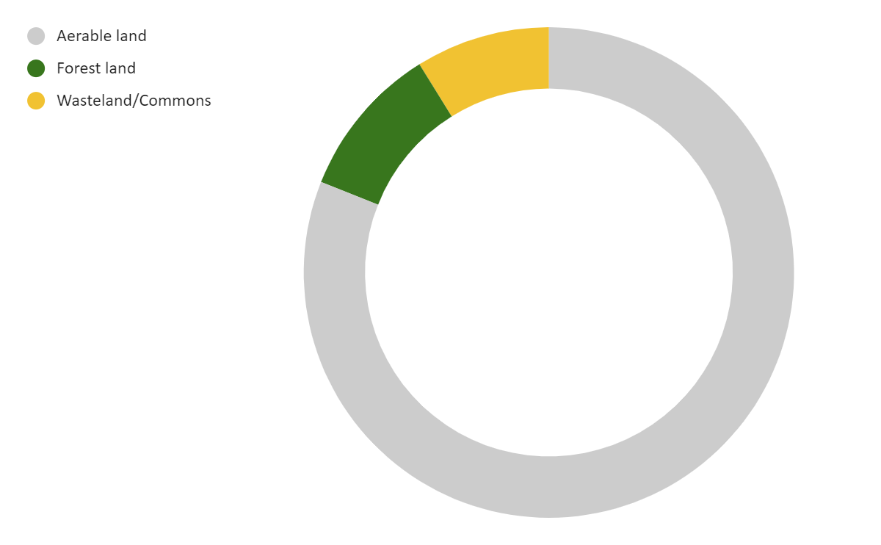
Land Profile I Farmers are largely using their own land for oil palm plantations, however across both states there are some who used leased land or common land
Profile of Plantations
86% of farmers are using their own land for growing oil palm while the rest are using leased or common land.
60% of total farmers in the survey have land titles, however only 31% of farmers in Assam have land titles or documents signifying ownership
While all land conversions occurring in AP are from agricultural land, in Assam some deemed forest lands, densely vegetated and common lands are also undergoing conversion to plantations.
However, availability of legal records, land titles is low in Assam
Distribution of nature of land conversion in Assam
In AP, oil palm plantation expansion follows recommendation of Dr Chadha & Dr Reithnam committees (2006 and 2012) which furnished the feasible areas for cultivation in the state.
Mandals are allotted to different companies and evaluations are conducted by IIOPR along with state department representatives based on field visits and inspections to select feasible areas.
9%
(n=78)
Distribution of percentage of farmers with land titles/ pattas
10%
10%
AP
Assam
81%
Percentage of farmers
(Assam: n=78)
Presence of pattas/titles/
documents signifying ownership
(AP: n=111)
No documentation
Farmers in AP have larger land parcels and have larger share of their own land allocated to oil palm. On the other hand, farmers in Assam have just started cultivation, and therefore have smaller land parcels allocated to the crop. This reflects higher importance given to the crop in AP, also corresponding to a higher share of household income derived from the crop (see slide 22)
Source: Primary Interviews across AP and Assam, Sattva Analysis
Notes:
Ranges to show overall how much land is being used
District wise = % average and ranges – % of land allocated for oil palm - insights on the farmer priorities and the perceived value of oil palm as a commercial crop
What is the average landholding size in both states? - represent using a column graph that has range of average landholding size?
Are farmers using their own land/or leased/common land for growing oil palm? Inter and intra-state variations. Is the nature of land rights customary or legally registered? Highlight any challenges in farmers obtaining ownership or land rights?- represent using bar graph?

Slide 48
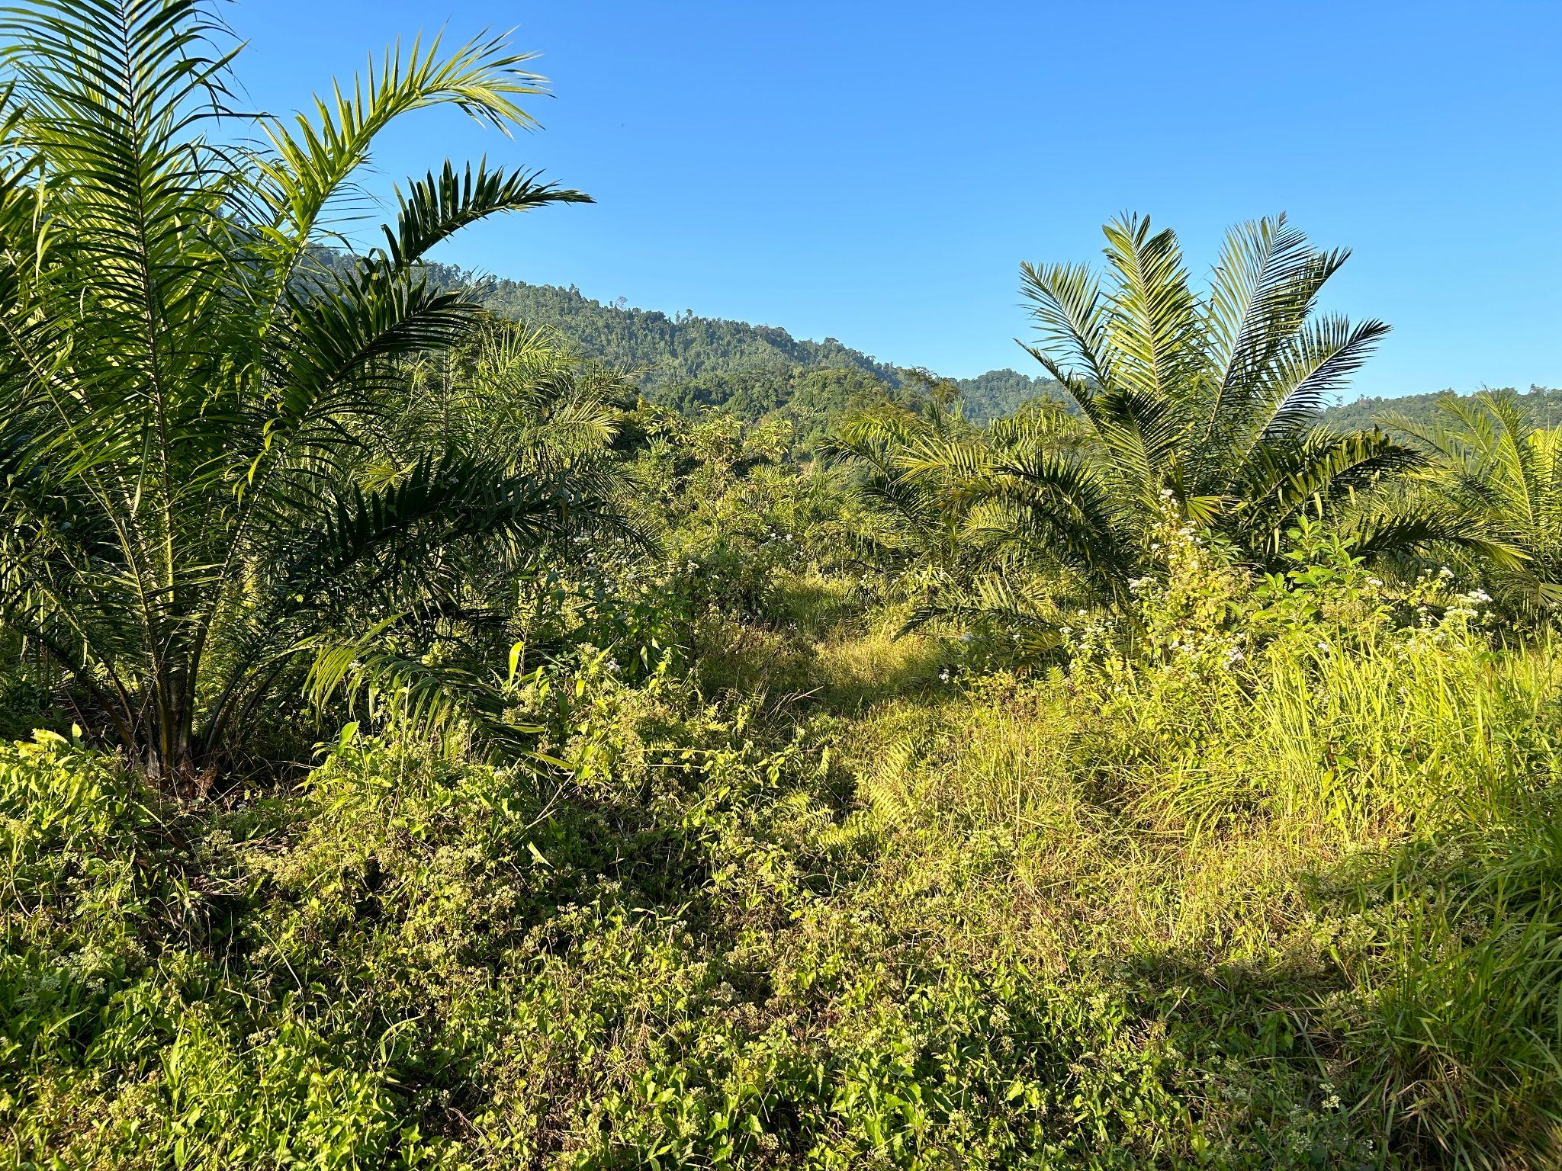
Focus on Land Conversions in Assam I Assam is undergoing land conversions for palm plantations as the area under palm is rapidly expanding
Andhra Pradesh (AP) has mature plantations, and the growth rate of palm plantations is lower in the state, as compared to Assam where the growth rate is higher. In AP, all of the land being converted into palm plantations are agriculture land- arable or land under permanent crops, Assam also has land with vegetation (forest lands), along with Commons such as pastures undergoing conversion into plantations.
Unpacking Land types in Assam
Land with dense vegetation- These lands are forest land or land with dense vegetation, in terms of ownership they are owned by the State Revenue dept or by Forest dept in some instances, however they do not form part of ‘protected areas’. In terms of use, these parcels have been used by tribal communities since decades, and although they do not have land titles, they have been controlling and managing the land since long.
Wastelands- India still follows the colonial terminology of classifying non-forested and non-agricultural lands as ‘wastelands’. Quite contrary to the term, these lands have been used since decades by communities as common property resources and serve important ecological, environmental and economic functions for communities.
In Assam, both of these land types have also been used for practicing shifting cultivation or ‘jhum’ by local communities.
Oil Palm plantation in a densely vegetated area in Dhemaji, Assam
Source: Primary Interviews across AP and Assam, Sattva Analysis
Notes:
Ranges to show overall how much land is being used
District wise = % average and ranges – % of land allocated for oil palm - insights on the farmer priorities and the perceived value of oil palm as a commercial crop
What is the average landholding size in both states? - represent using a column graph that has range of average landholding size?
Are farmers using their own land/or leased/common land for growing oil palm? Inter and intra-state variations. Is the nature of land rights customary or legally registered? Highlight any challenges in farmers obtaining ownership or land rights?- represent using bar graph?

Slide 49
Land Use I Size of plantations vary inter- and intra-state, Andhra Pradesh has larger average land parcels used for plantations as compared to Assam
Profile of Plantations
88% of landowning farmers in AP and only 32% of landowning farmers in Assam are are using more than 80% of their land to grow oil palm.
Most farmers across AP have allocated almost all of their landholding to oil palm, however across Assam, mature farmers have more share of land allocated to palm compared to those in gestation period, indicating lower maturity of the crop within the state, and lower importance given by new farmers
 | % of total land ownership owned being used for palm plantations
 | Gestation Phase | Harvesting <5 yrs | Harvesting >5 yrs
Assam | 48% | 68% | 96%
AP | 96% | 100% | 91%
Distribution of landholding used for oil palm cultivation across Assam and AP
Plantation landholdings are larger in AP compared to Assam, with a significant number of farmers (~33%) using land more than 1 Ha for the plantations in AP. Compared to this, majority of plantations in Assam (~75%) are less than 1 Ha in size.
3.7%
1.8%
(n=111)
2.6%
(n=78)
Percentage of oil palm farmers
Farmers in AP have larger land parcels and have larger share of their own land allocated to oil palm, farmers in Assam have just started cultivation, and therefore have smaller land parcels allocated to the crop. This reflects higher importance given to the crop in AP, also corresponding to a higher share of household income derived from the crop (see slide 22)
Source: Primary Interviews across AP and Assam, Sattva Analysis
Notes:
Ranges to show overall how much land is being used
District wise = % average and ranges – % of land allocated for oil palm - insights on the farmer priorities and the perceived value of oil palm as a commercial crop
What is the average landholding size in both states? - represent using a column graph that has range of average landholding size?
Are farmers using their own land/or leased/common land for growing oil palm? Inter and intra-state variations. Is the nature of land rights customary or legally registered? Highlight any challenges in farmers obtaining ownership or land rights?- represent using bar graph?

Slide 50
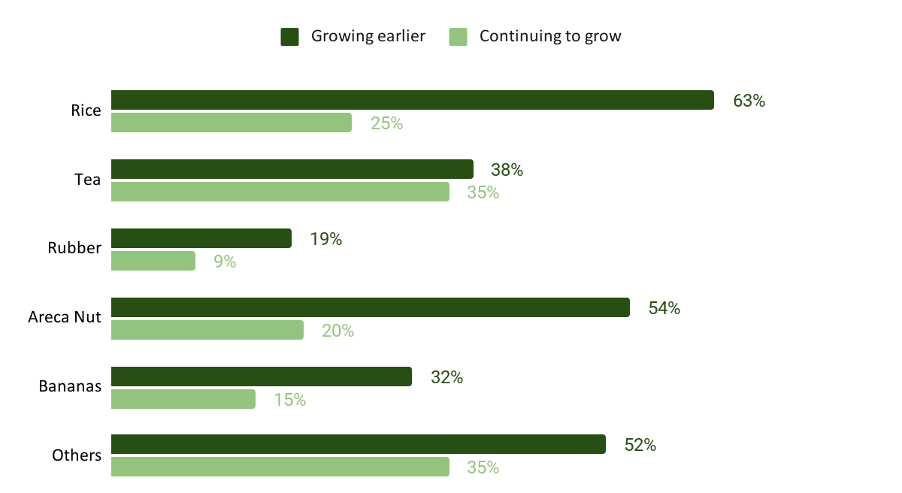
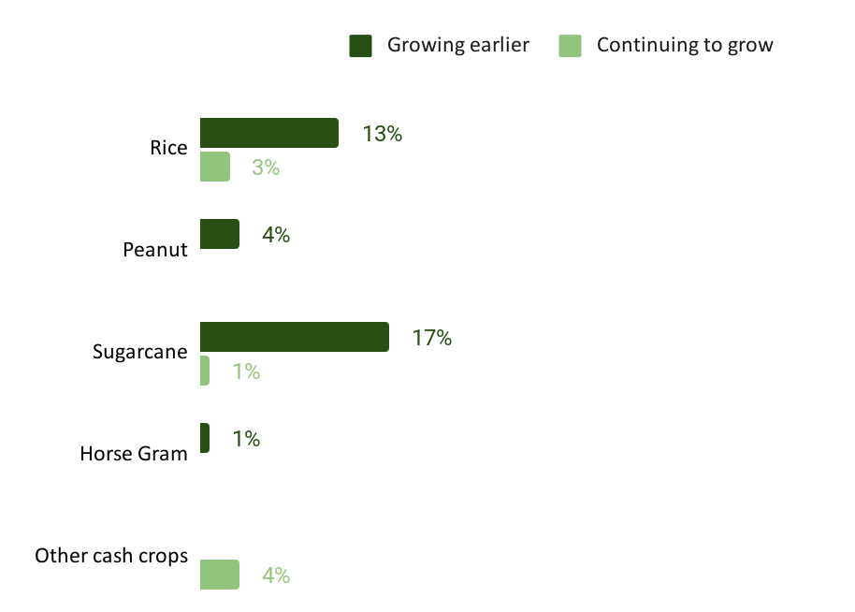
Crop Profile I 54% of the farmers planted other crops prior to growing oil palm, majority of these farmers are from Assam and the notable cash crops are Areca Nut, Rubber, and Tea
“
25%
farmers in AP
96%
farmers in Assam
were growing other crops before taking up oil palm.
I was not using this patch of land earlier, and growing rubber and areca nut in other patches of land I own.. Also I grow rice in a small patch for household consumption.
I started growing oil palm around 5-6 years ago, when other farmers in Goalpara started…
Farmer (M, 45)
Goalpara, Assam
Farmers in Assam
Farmers in AP
(n=78)
(n=111)
“
Oil palm is lucrative for farmers, as with increase in the number of years of growing the crop, farmers allocate more land to palm plantations and reduce cultivation of other crops to shift entirely to oil palm plantations
Source: Primary Interviews across AP and Assam, Sattva Analysis
Notes:
What were the farmers previously growing before oil palm and currently growing along with oil palm? Intra and inter state differences?

Slide 51
Crop Profile I Farmers in Assam are intercropping palm with other crops, and also availing Govt subsidies for the same, while farmers in AP find the plantations unsuitable for the growth of any other crops
Intercropping Practices
~70% of farmers in Assam are practicing intercropping within oil palm plantations. Farmers are most commonly taking up growing fruits & vegetables and nuts and spices in-between the palm plantations.
The mature palm plantations seen in AP are unsuitable for intercropping, as stated by farmers.
Back
Distribution of various intercropping patterns in Assam
“
Rubber
In AP, farmers growing oil palm for more than 7 years rarely do intercropping, however in Assam plantations >7 years old also have intercropping
Farmers in Assam have cited a challenge of the oil palm trees taking up more resources, however specific crops like pineapple, mustard, sesame that are drought resistant thrive well
Intercropping can be practiced until the 2 years of planting the seed. Once the tree starts growing, we remove the crops grown around it to ensure the oil palms gets the necessary nutrients.
Farmer (M, 58)
Krishna, AP
Banana
Mustard
Farmers in Assam
Areca Nut
Sesame
(n=78)
Lemon
Pineapple
“
Vegetables
Oil palm is lucrative for farmers, as with increase in the number of years of growing the crop, farmers stop cultivating other crops, and have a tendency to shift entirely to oil palm plantations
Notes:
What were the farmers previously growing before oil palm and currently growing along with oil palm? Intra and inter state differences?

Slide 52
II. Farming Practices

Slide 53
Nature of Plantation and Farming Practices I Primary research conducted by Sattva among the smallholder farmers have provided insights across various farming practices
Fertilizer
Irrigation
Type of fertilizer used
Cost incurred on fertilizer
Source of water
Mode of irrigation
Cost incurred on irrigation
Energy
Labour
Source and use of energy
Cost incurred on energy
Source of labour
Activities undertaken by labour
Cost incurred on labour
Notes:
What are the farming practices in terms of seed?

Slide 54
Irrigation I While majority of farmers in Assam (82%) practice rainfed cultivation of oil palm, all plantations in AP rely on irrigation systems
Source of Water for Irrigation
The three prominent sources of water for irrigation are ground, canal/river and rainwater.
Majority of farmers in Assam rely on rainfed agriculture. ~80% farmers use rainwater as a major source for irrigation.
In AP, 100% of the farmers rely on groundwater for irrigation.
Method of Irrigation
Dominant methods of irrigation in both Assam and AP are Basin Method and Drip or Microjet Method of irrigation.
34% of farmers in AP have both Basin and Drip irrigation method. 53% use drip irrigation exclusively and rest 13% use only basin irrigation method.
18% of farmers in Assam have either Basin or Drip irrigation
AP
AP
(n=78)
~13%
~53%
Both~34%
Farmers in both states
(n=78)
Farmers in both states
Assam
Assam
~8%
~10%
Rainfed ~82%
~14%
(n=111)
(n=111)
The success of oil palm cultivation in Assam is significantly supported by its abundant rainfall. However, approximately 40% cited the absence of irrigation facilities as a challenge. This issue arises from the erratic nature of rainfall, leading to prolonged periods of drought lasting 3-4 months, during which farmers experience complete yield loss.
Source: Primary Interviews across AP and Assam, Sattva Analysis
Notes:
What are the farming practices in terms of seed?

Slide 55
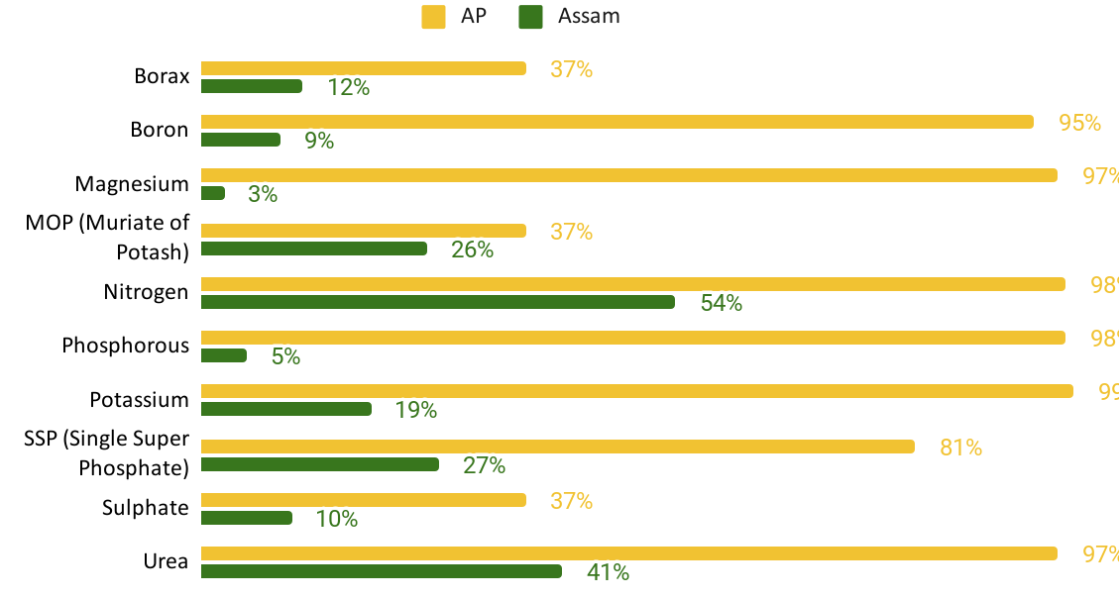
Fertilizers I Farmers in AP use variety of fertilizers to boost productivity of plantations (49% of farmers use more than 8 fertilizers) as compared to Assam where fertilizer usage is nominal (96% of farmers use less than 5 fertilizers)
List of fertilizers used by farmers in AP and Assam respectively
Reason of Low Fertilizer Usage in Assam
Lack of information regarding fertilizers, the specific nutrient requirements of oil palm, and the importance of addressing nutritional imbalances.
Farmers without land titles to the land parcels used for plantations fail to avail govt subsidies for fertilizers. Farmers are reluctant to spend out to pocket on fertilizers and any other inputs in the absence of a proper market and processing centres within the state, as they do not receive proper price on selling the harvest
Cost of Fertilizer
The average cost of applying fertilizer is around 4000 per acre in Assam whereas it is around 12000 per acre in AP.
In Assam, farmers with less than one year old plantations and those with 4-7 year old plantations report a greater usage of fertilizers as compared to plantations in the gestation period (1-4 years) or more than 7 year old plantations. This also indicates a negative sentiment few farmers have developed towards the crop, due to unavailability of buyers, and proper market in the Goalpara district
Source: Primary Interviews across AP and Assam, Sattva Analysis
Notes:
What are the farming practices in terms of seed?

Slide 56
Fertilizers I Based on the available data on land profiles in Andhra Pradesh and Assam, farmers are not using the optimum amount of fertilizer which affects productivity
Andhra Pradesh
Assam
Key Takeaways
In AP, given the low presence of nitrogen and phosphorous in the soil, the high usage of these fertilizers seems to be a positive trend
In Assam, there is low use of phosphorus, potassium and boron despite its deficiency in the soil potentially negatively impacting productivity and sustainability
Boron, a key fertilizer promoting oil palm growth is being used by almost all farmers in Andhra Pradesh (~95%) despite most areas in the state with soil sufficient or high in it
Nutrient | Usage¹ | Presence in soil² |  |  | Usage | Presence in soil²
 |  | High / Sufficient | Medium | Low / Deficient |  | High / Sufficient | Medium | Low / Deficient
Nitrogen | 98% | 2.73% | 20.48% | 76.79% | 54% | 23.58% | 33.11% | 43.32%
Phosphorous | 98% | 30.47% | 50.36% | 19.17% | 5% | 4.56% | 63.13% | 32.31%
Potassium | 99% | 77.03% | 12.16% | 10.82% | 19% | 1.53% | 28.64% | 69.83%
Boron | 95% | 91.25% | - | 8.75% | 9% | 12.19% | - | 87.81%
Note: Data was collected from smallholder farmers on the access of fertilizers and identification of fertilizer types used on fields, accurate data on the rate of application of fertilizers was not collected, also indicating the lack of knowledge of accurate measurements among farmers and need for technical training.
There seems to be unregulated use of fertilizers with underuse in Assam and both under and overuse in Andhra Pradesh.
Source: 1. Primary surveys, Analysis by Sattva, 2. ASSAM - Soil Fertility Maps of Cycle-II data of Soil Health Card (SHC) Scheme, Soil Health Card - Nutrient Dashboard
Notes:
What are the farming practices in terms of seed?

Slide 57
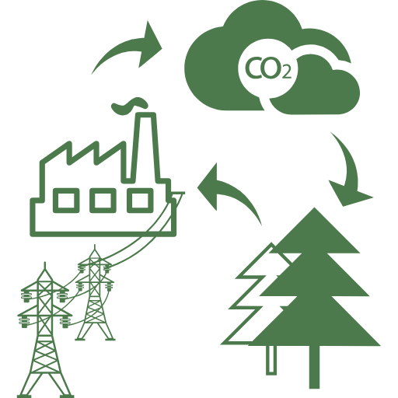
Energy I In Assam the average cost incurred for energy consumption is fairly low as compared to AP as only 23% farmers in Assam use any source of energy
Source of Energy
There are two main sources of energy, i.e. Renewable and Conventional energy.
26% farmers use only renewable sources, 50% farmers rely on only conventional/grid energy while the remaining use both sources of energy in AP
5% farmers in Assam use renewable energy and rest 18% use conventional/grid energy
AP
Renewable 26%
Grid 50%
Both 24%
(n=111)
Farmers in both states
Renewable 5%
Assam
Grid 18%
No energy used 77%
(n=78)
Cost of Energy
Govt provides free electricity to most of the farmers however there are few farmers who use fuel as a source of energy, these farmers incur a substantial cost.
23% farmers incur the cost of energy of which the average cost is ~INR 3000* per year in Assam
66% farmers incur the cost for energy consumption of which the average cost is around ~INR 9000 per year in AP
AP
(n=111)
Farmers in both states
Assam
(n=78)
Average cost of energy incurred by farmers in a year
The cost of energy is same in both the states however in Assam very few farmers (23%) use any energy for cultivation, on the other hand AP has a high percentage of farmers utilizing energy within the plantations. Conducive environment and geographical features of Assam reduces the need for extensive irrigation, thereby lowering the need of energy required for water supply.
*This data has been optimized and extreme figures of farmers who have incurred cost more than 30,000 have been removed from the average calculation.
Source: Primary Interviews across AP and Assam, Sattva Analysis
Notes:
What are the farming practices in terms of seed?

Slide 58
Labour I Most farmers do not hire external farm labour in Assam whereas there is a greater reliance on external labour in AP
Assam, n=78 AP, n=111
Fencing for plantations is not required in AP, however in Assam ~80% of farmers hire external labour for fencing their plantations to protect from animal attacks.
1 in 2 farmers hire external labourers for weeding in Assam, while 84% farmers in AP hire external labourers for the same.
Farmers in Assam also need labourers for land preparation before plantations to carry out digging and land clearance, 28% hire external labourers for the same.
50% farmers in Assam hire external labourers for planting seedlings, compared to AP where ~2X farmers hire external labourers for planting seedlings.
Farmers in AP extensively use bio/organic manure. 77% farmers within the sample in AP hire external labour for manure application. Assam farmers do not use organic manure extensively.
84% farmers in AP hire external labourers for Irrigation- largely to oversee irrigation on plantations while in Assam irrigation is largely rainfed, requiring no labour usage.
Farmers (91%) in AP hire external laborers for fertilizer application on their fields, however in Assam labour utilization is less on this activity as the rate of fertilizer application is low there.
Most farmers across both state utilize household labor for harvesting the crop. Only 26% farmers in Assam and 34% farmers in AP hire external labourers for harvesting.
There exists variation in Labour usage across both states, in Assam labour is being used largely by farmers who have been farming for <1 year and 4-7 years, i.e. in setting up the plantation and the initial harvesting years, while more farmers in AP rely on external labour for specific activities such as manure application, weeding and overseeing irrigation.
Source: Primary Interviews across AP and Assam, Sattva Analysis

Slide 59
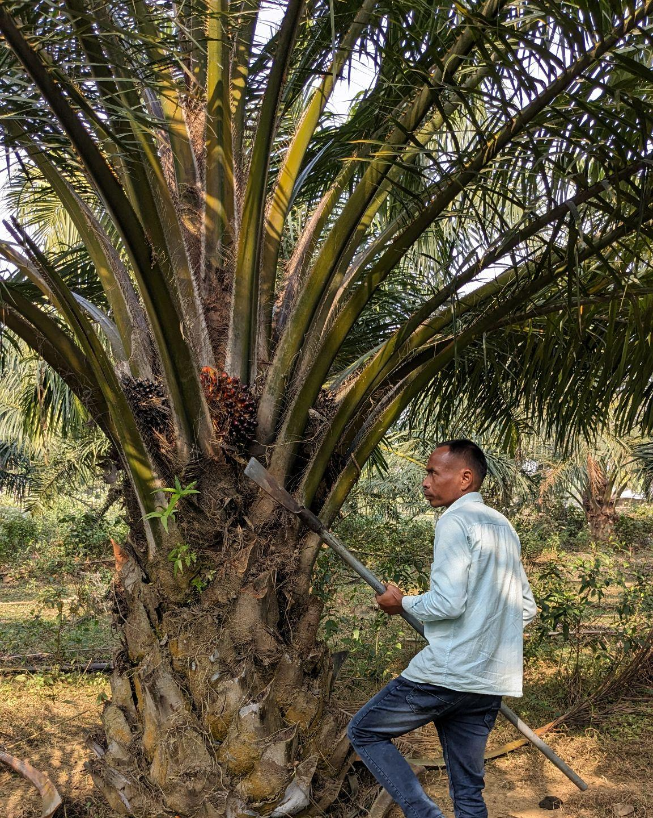
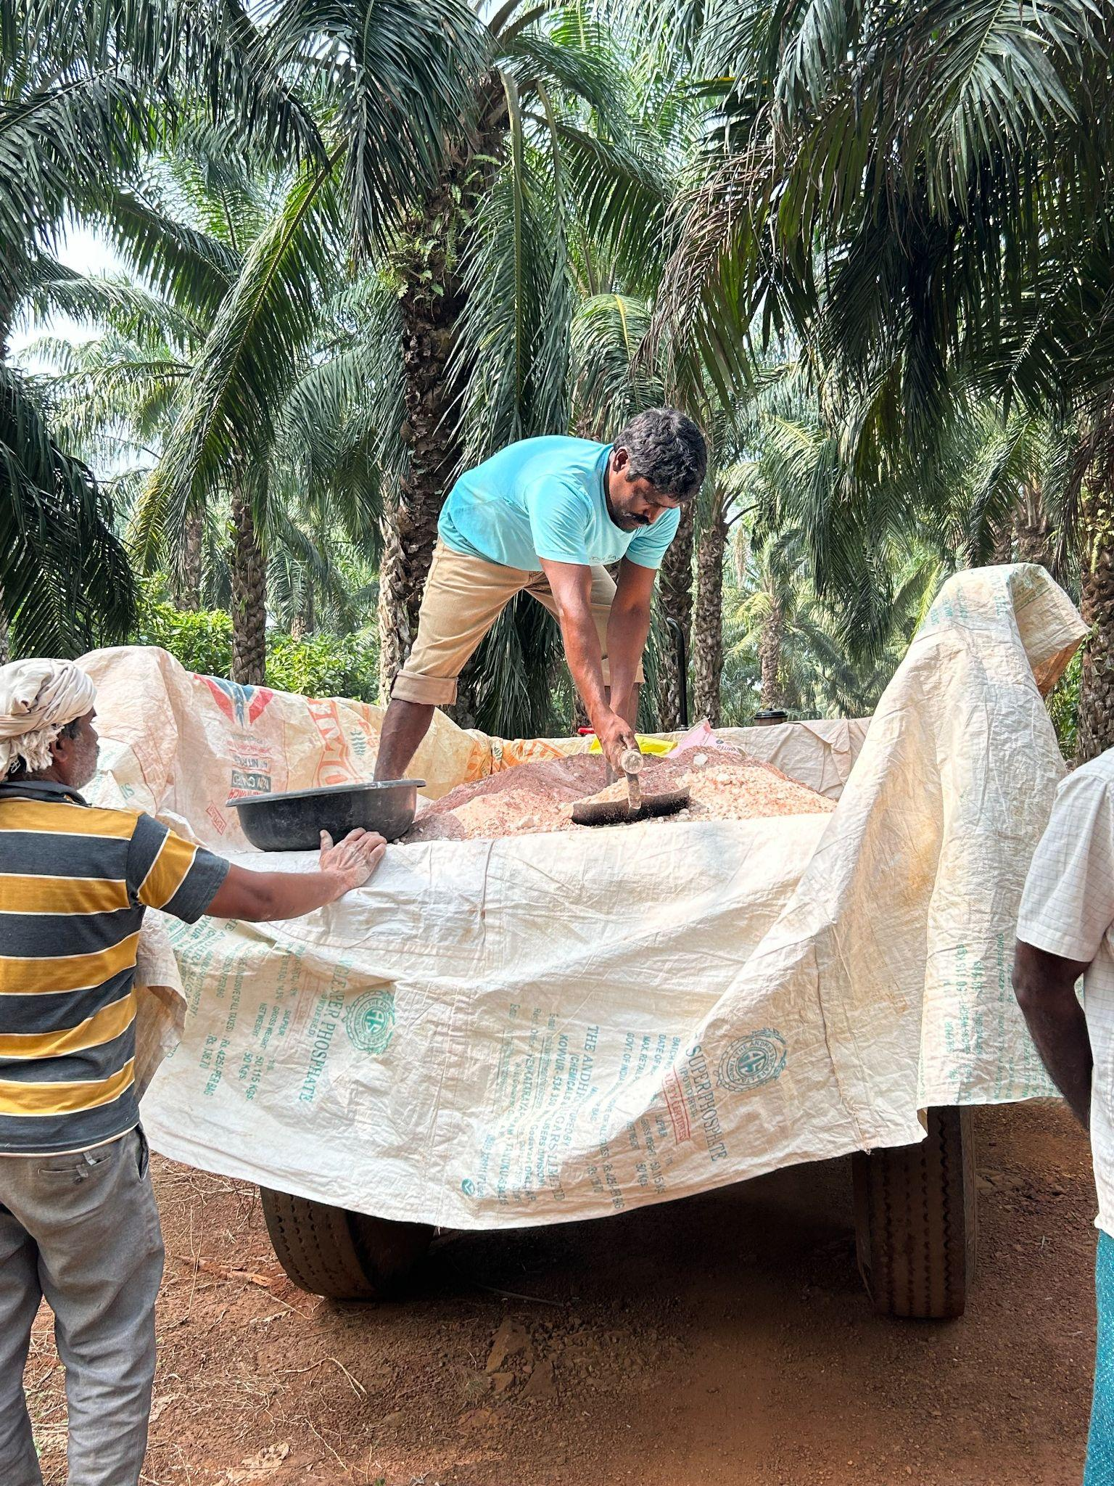
Labour I The external labour is largely local contractual workers and not migrant in Assam (91%) and AP (71%), these workers are hired for carrying out various farming activities
Migrant vs. Local Contractual Labourers
Oil Palm cultivation in both the states is carried out mostly labours hired locally on contract basis.
9% farmers in Assam reported that they hire migrant labourers (n=45)
29% farmers in AP reported that they hire migrant labourers (n=103)
Cost of Labour
The farmers is Assam incur a labour cost of ~3500 on an average per acre for a year. On the contrary, the average spending of a farmer in Andhra Pradesh is around ~11000 per acre.
“
We hire women labourers only for cleaning activities in the field… for other activities like harvesting and loading of bunches on tractor they are not suitable as it requires a lot of manual strength
Farmer (M, 63), West Godavari, AP
Male vs. Female Labourers
Oil Palm is a mainly a male dominated activity. This is true for the labourers hired for carrying out various farming operations as well.
73% farmers in Assam hire only men, 24% hire men and women both whereas only 2% farmers hire only female labourers.
6% farmers in AP hire only male labourers and rest 94% hire both male and female labourers
“
From L-R: 1. Farm labourer harvesting FFBs in Goalpara, Assam
2. Farm labourers applying fertilizers in West Godavari district, AP
Source: Primary Interviews across AP and Assam, Sattva Analysis
Notes:
What are the farming practices in terms of seed?

Slide 60
III. Constraints Faced by Smallholders

Slide 61
Constraints I Key Pre-farm constraints and % of farmers across various archetypes facing them
Assam
Andhra-Pradesh
Farmers in Gestation Period
Farmers Harvesting
<5 years
Farmers Harvesting
>5 years
Farmers in Gestation Period
Farmers Harvesting
<5 years
Farmers Harvesting
>5 years
100% Farmers using less than 5 fertilizers | 30% Farmers using less than 5 fertilizers | 25% Farmers using less than 5 fertilizers
84% Farmers don't have irrigation system | 78% Farmers don't have irrigation system | 63% Farmers don't have irrigation system
2% Farmers suffering with disease infestation | 26% Farmers suffering with disease infestation | 13% Farmers suffering with disease infestation
2% Farmers are not receiving subsidies / paying cost for seeds | 13% Farmers are not receiving subsidies / paying cost for seeds | 0% Farmers are not receiving subsidies / paying cost for seeds
9% Farmers using less than 5 fertilizers | 0% Farmers using less than 5 fertilizers | 2% Farmers using less than 5 fertilizers
0% Farmers don't have irrigation system | 0% Farmers don't have irrigation system | 0% Farmers don't have irrigation system
43% Farmers suffering with disease infestation | 64% Farmers suffering with disease infestation | 72% Farmers suffering with disease infestation
30% Farmers are not receiving subsidies / paying cost for seeds | 32% Farmers are not receiving subsidies / paying cost for seeds | 48% Farmers are not receiving subsidies / paying cost for seeds
Fertilizers
Irrigation
Disease Infestation
Seeds

Slide 62
Constraints I Key Constraints and % of farmers across various archetypes facing them
Assam
Andhra-Pradesh
Farmers in Gestation Period
Farmers Harvesting
<5 years
Farmers Harvesting
>5 years
Farmers in Gestation Period
Farmers Harvesting
<5 years
Farmers Harvesting
>5 years
38% Farmers are not doing intercropping | 38% Farmers are not doing intercropping | 12% Farmers are not doing intercropping
13% Farmers incur more than average cost of energy | 22% Farmers incur more than average cost of energy | 13% Farmers incur more than average cost of energy
24% Farmers incur more than average labour cost | 35% Farmers incur more than average labour cost | 50% Farmers incur more than average labour cost
NA | 96% Farmers are not receiving NMEO-OP price | 88% Farmers are not receiving NMEO-OP price
83% Farmers are not doing intercropping | 100% Farmers are not doing intercropping | 98% Farmers are not doing intercropping
26% Farmers incur more than average cost of energy | 20% Farmers incur more than average cost of energy | 26% Farmers incur more than average cost of energy
39% Farmers incur more than average labour cost | 32% Farmers incur more than average labour cost | 45% Farmers incur more than average labour cost
N/A | 16% Farmers are not receiving NMEO-OP price | 9% Farmers are not receiving NMEO-OP price
Intercropping
Energy
Labour
Market Linkage

Slide 63
Constraints I Key Constraints and % of farmers across various archetypes facing them
Assam
Andhra-Pradesh
Farmers in Gestation Period
Farmers Harvesting
<5 years
Farmers Harvesting
>5 years
Farmers in Gestation Period
Farmers Harvesting
<5 years
Farmers Harvesting
>5 years
96% Farmers are not part of FPOs / Cooperatives | 57% Farmers are not part of FPOs / Cooperatives | 38% Farmers are not part of FPOs / Cooperatives
NA | 72% Farmers incurring transportation cost with no reimbursement | 88% Farmers incurring transportation cost with no reimbursement
51% Farmers reporting this challenge | 9% Farmers reporting this challenge | 0% Farmers reporting this challenge
7% Farmers do not have ownership of land | 26% Farmers do not have ownership of land | 13% Farmers do not have ownership of land
83% Farmers are not part of FPOs / Cooperatives | 80% Farmers are not part of FPOs / Cooperatives | 69% Farmers are not part of FPOs / Cooperatives
NA | 0% Farmers incurring transportation cost | 0% Farmers incurring transportation cost
0% Farmers reporting this challenge | 0% Farmers reporting this challenge | 0% Farmers reporting this challenge
13% Farmers do not have ownership of land | 24% Farmers do not have ownership of land | 12% Farmers do not have ownership of land
Cooperatives
Transportation
Human-animal Conflict
Land Rights

Slide 64
Constraints I Key Constraints and % of farmers across various archetypes facing them
Assam
Andhra-Pradesh
Farmers in Gestation Period
Farmers Harvesting
<5 years
Farmers Harvesting
>5 years
Farmers in Gestation Period
Farmers Harvesting
<5 years
Farmers Harvesting
>5 years
89% Farmers do not have access to soil testing | 83% Farmers do not have access to soil testing | 75% Farmers do not have access to soil testing
4% Farmers reported climate change & extreme weather events as a challenge | 22% Farmers reported climate change & extreme weather events as a challenge | 0% Farmers reported climate change & extreme weather events as a challenge
55% Farmers do not have access to soil testing | 37% Farmers do not have access to soil testing | 47% Farmers do not have access to soil testing
35% Farmers reported climate change & extreme weather events as a challenge | 60% Farmers reported climate change & extreme weather events as a challenge | 72% Farmers reported climate change & extreme weather events as a challenge
Soil Quality
Climate Change

Slide 65
IV. Andhra Pradesh

Slide 66
Subsidies in Andhra Pradesh
Sl. No. | Name of the Component/ Services | Unit | Total Unit cost (Rs) | Financial Assistance (%) | Financial Assistance (Rs) | Maximum subsidy limit (Rs) | Remarks
1 | Plant Material | Ha | 20000 Indigenous & 29000 Imported per Ha | 100 | 20000 Indigenous & 29000 Imported per Ha | entire landholding
2 | Maintenance Cost | Ha | 42000.00 | 50 | 21000 | 21000 | @ Rs.5,250/- per Ha for 4 years
3 | Drip Irrigation | Ha |  |  | 24035 |  | As per PMKSY guidelines
4 | Pump sets/ Diesel engine | No | 45000.00 | 50 | 22500 | 22500
5 | Bore well | No | 100000.00 | 50 | 50000 | 50000
6 | Inputs for inter crop | Ha | 42000.00 | 50 | 21000 | 21000 | Rs.5,250/-for 4 years
7 | Vermi Compost units | No | 30000.00 | 50 | 15000 | 15000
8 | Machinery & Tools
 | a) Oil palm cutter. | No | 5000.00 | 50 | 2500 | 2500
 | b) Oil palm protective wire mesh | No | 40000.00 | 50 | 20000 | 20000
 | c)Motorized chisel | No | 30000.00 | 50 | 15000 | 15000
 | d)Aluminum Portable ladder | No | 10000.00 | 50 | 5000 | 5000
 | e) Chaff Cutter | No | 100000.00 | 50 | 50000 | 50000
 | f) Small tractor | No | 400000.00 | 50 | 200000 | 200000
9 | Farmers Training | No |  |  | 30000 |  | for a batch of 30 farmers for 2 days
10 | Training of extension officers | No |  |  | 40000 |  | for a batch of 20 officers for 2 days
11 | Replanting of old oil palm garden | No | 250.00 | 100 | 250
Source: Information shared by Additional Director of Horticulture (Planning, Establishment, RKVY & NMOOP), Andhra Pradesh

Slide 67
Formation and Promotion of 10,000 Farmer Producer Organizations (FPOs)
The Government of India launched this Central Sector Scheme in the year 2020 with a total budgetary outlay of INR 6865 Crores to enable farmers to enhance their bargaining power, leverage economies of scale, reduction in cost of production and enhancing farmers’ incomes through aggregation of their agricultural produce, thus playing a major role towards sustainable incomes.
Provisions of the scheme are as follows:
FPOs being provided financial assistance upto Rs.18.00 lakh per FPO for a period of 03 years.
In addition to this, provision has been made for matching equity grant upto Rs.2,000 per farmer member of FPO with a limit of Rs.15.00 lakh per FPO
Credit guarantee facility upto Rs.2 crore of project loan per FPO from eligible lending institution to ensure institutional credit accessibility to FPOs.
Rs.25 Lakhs are given to Cluster Based Business Organizations (CBBO) for hand holding each FPO over a period of five years.
Progress in Andhra Pradesh
As on 30.11.2023, under the said scheme so far, 461 FPOs were allocated in the State of Andhra Pradesh of which 355 FPOs are registered.
The following table represents district-wise number of FPOs allocated for the districts covered under the study:
District | No. of FPOs
East Godavari | 20
Eluru | 28
Srikakulam | 12
West Godavari | 5
Krishna | 23
Source: FORMATION OF FPOS IN ANDHRA PRADESH
Notes: Out of the study districts, Nellore was not mentioned in the list and the crops were not specified in the document

Slide 68
References

Slide 69
Sources for Secondary Research (1/2)
# | Source and Link
1 | NMEO-OP Guidelines (Nov 2021)
2 | Andhra Horticulture Department
3 | Oil palm in Andhra Pradesh: prosperity at what cost?
4 | Oil palm expansion in northeast India gives rise to human-elephant conflict concerns
5 | Oil palm plantations proved to be a disaster in Mizoram — is Assam next?
6 | 3F Oil Palm signs Rs 550 crore pact with Andhra for plantation, processing
7 | Vision 2050 - IIOPR
8 | Sustainable Palm Oil Good Agriculture Practices Guideline
9 | Palm Oil Market and Sustainability in India (2013)
10 | FERTILE GROUND — INDIA’S DOMESTIC PALM OIL INITIATIVE IS A SPRINGBOARD FOR SUSTAINABLE PRODUCTION
11 | Responsible Business Practices in the Indian Palm Oil Sector (2014)
12 | India needs to make palm oil production sustainable
13 | India’s palm oil drive faces reality check
14 | Oil palm farmers in Arunachal Pradesh lose hope in absence of processing mills, market, road linkage
15 | India’s Palm Oil Push Leaves Northeast Indian Farmers, Forests at Risk
16 | Why Meghalaya plans to stay away from Palm Oil plantations
17 | Oil palm in the 2020s and beyond: challenges and solutions
18 | STATUS PAPER ON OIL PALM
19 | Andhra Pradesh sets sight on Oil Palm Cultivation
Notes:
What were the farmers previously growing before oil palm and currently growing along with oil palm? Intra and inter state differences?

Slide 70
Sources for Secondary Research (2/2)
# | Source and Link
20 | Oil palm push in the northeast may impact biodiversity, water table, say experts | Latest News India - Hindustan Times
21 | Oil palm in Assam: Non-remunerative price and adverse impact on intercropping compel a section of farmers in Goalpara and Kamrup to withdraw from it
22 | Improving the Livelihoods of Palm Oil Smallholders: the Role of the Private Sector
23 | Oil Palm Cultivation Best Practices by IIOPR-ICAR
24 | Wastelands of India – Peepli
25 | How India's palm oil push is changing land relations in the North East
Notes:
What were the farmers previously growing before oil palm and currently growing along with oil palm? Intra and inter state differences?

